Slide 1
AI-enabled Intelligent Assistant to Improve Reading and Comprehension Skills in English Language
24-25J-027
Notes:
Welcome to the proposal presentation of our research project, "AI-enabled Intelligent Assistant to Improve Reading and Comprehension Skills in English Language

Slide 2
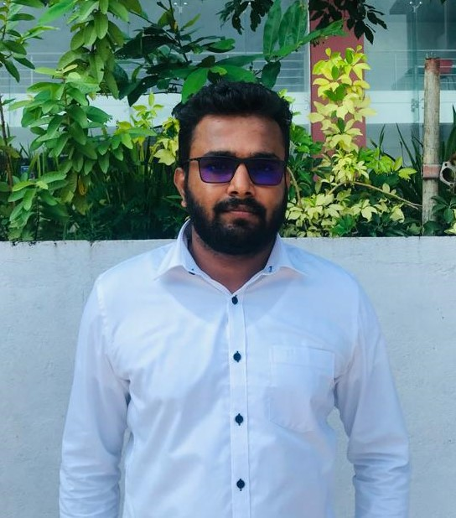
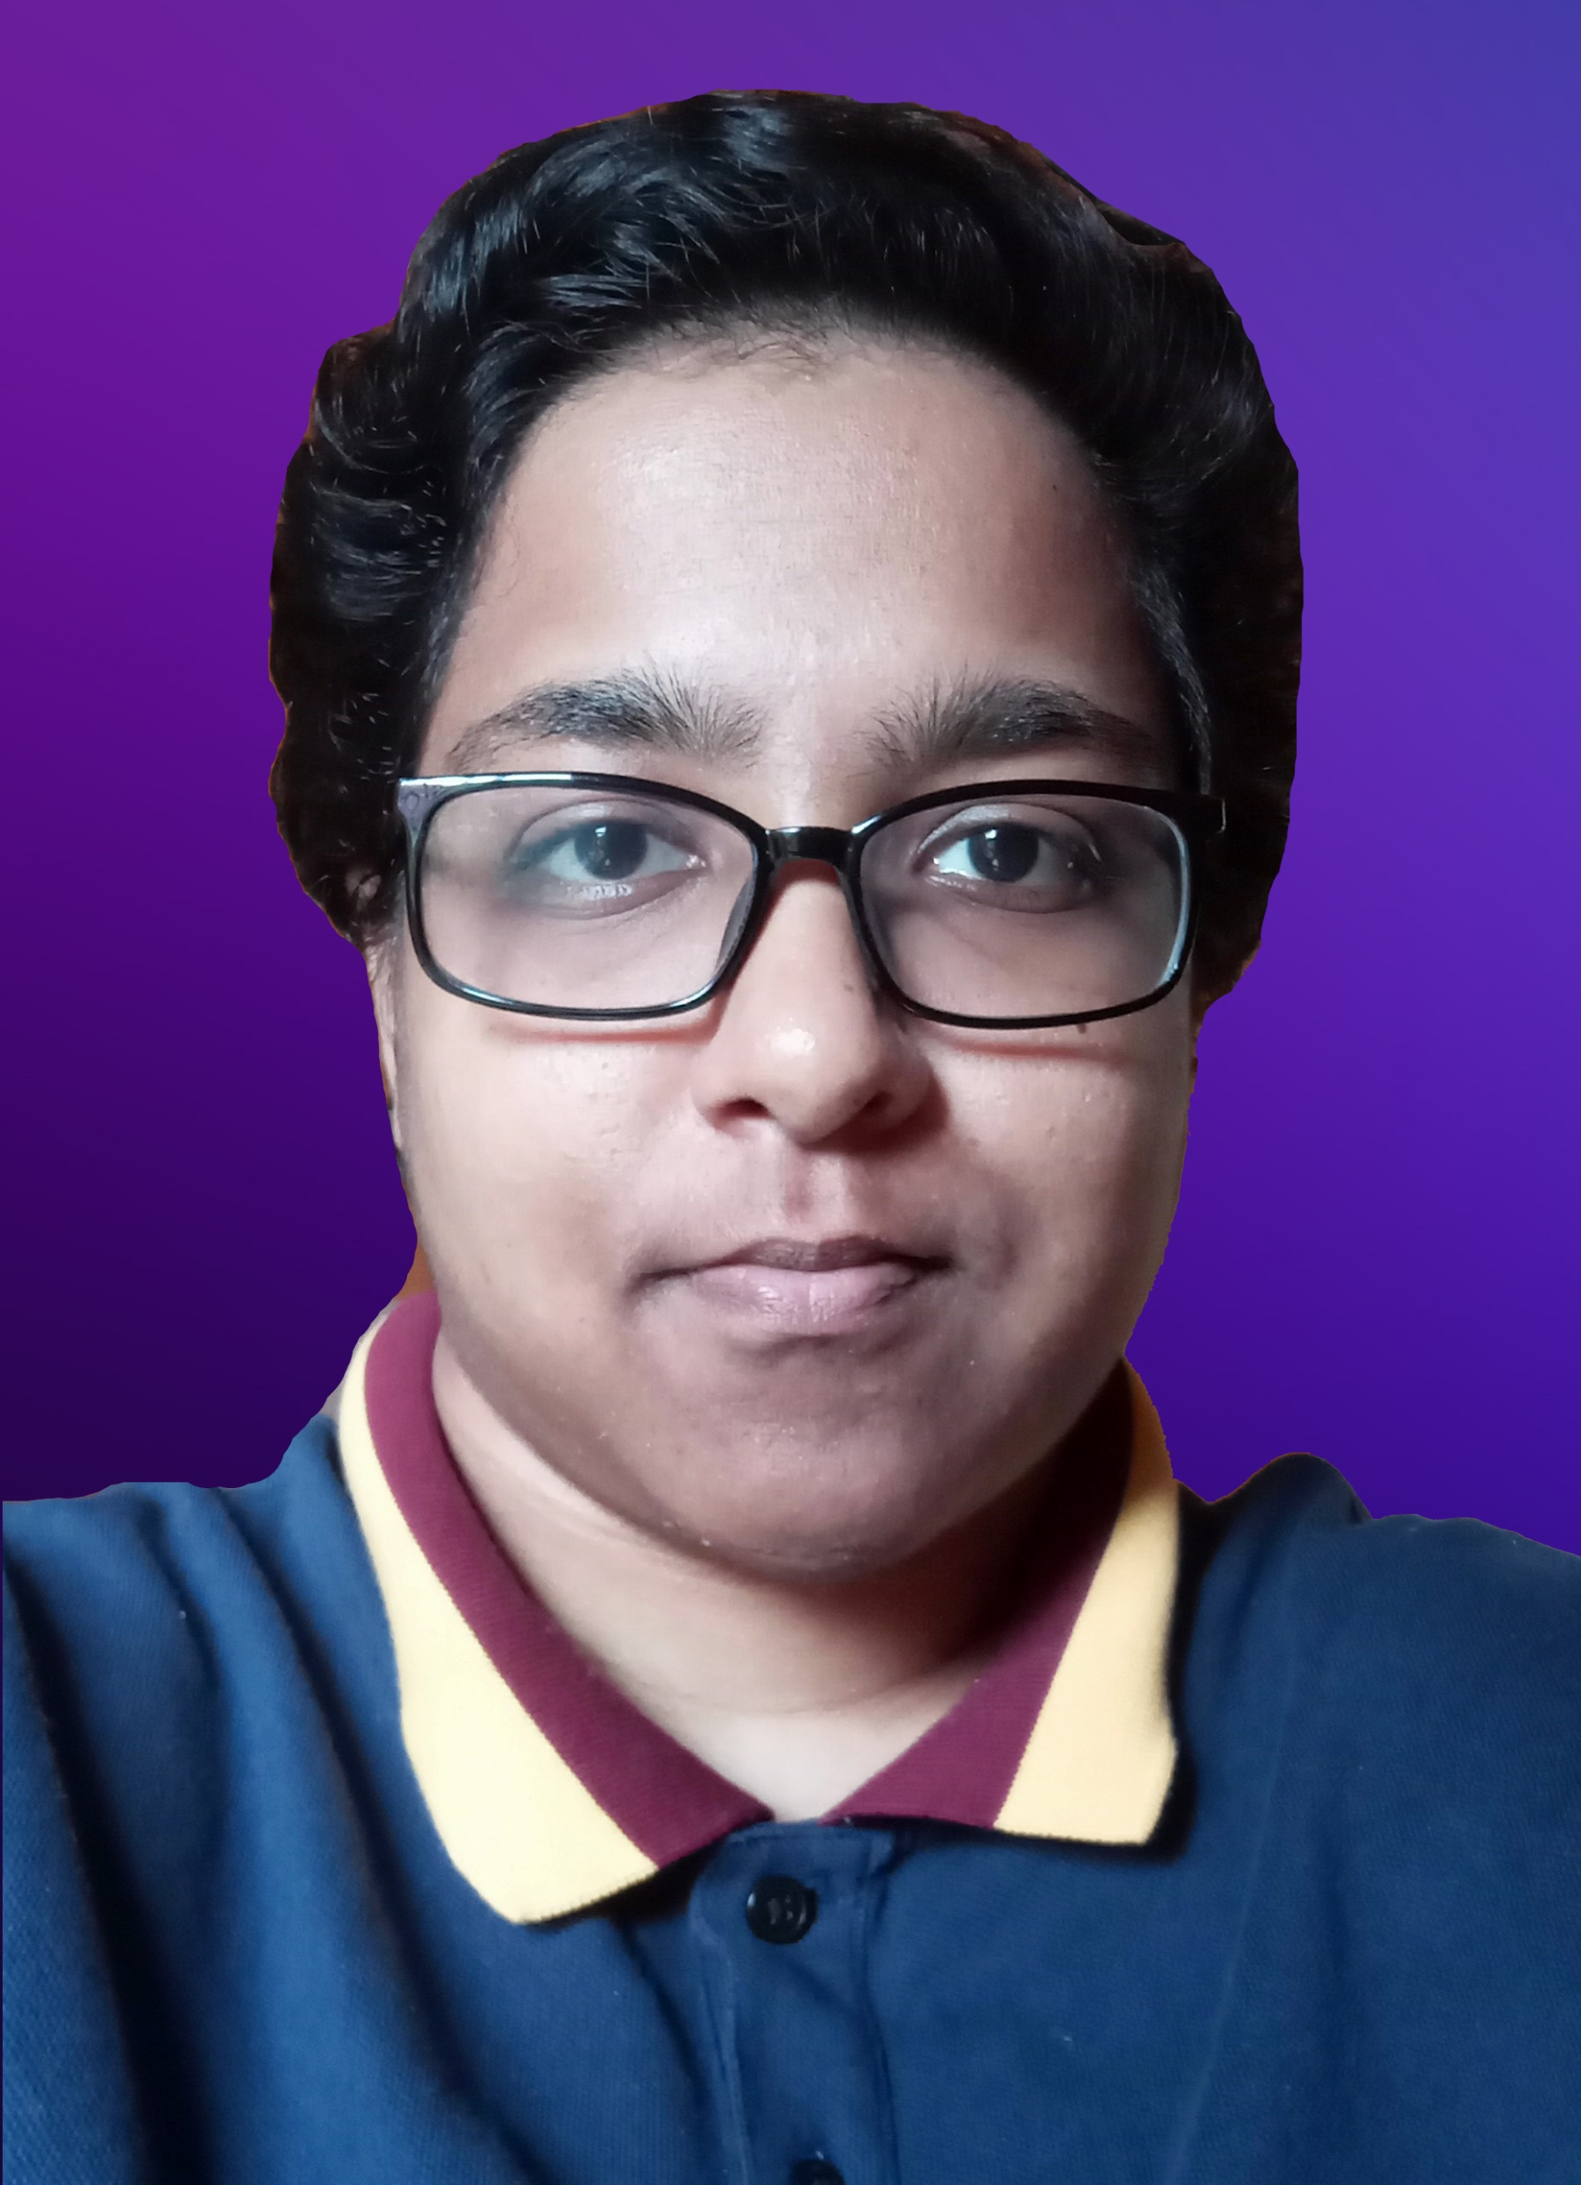



Our Team
Ranaweera A.P.
IT21182396
Kumarathunga S. A. D. S.
IT21182396
Sooriyaarachchi M.D.A.
IT21173790
Senanayake W.G.B.
IT21158322
3/18/2025
2
Notes:
This is our team

Slide 3


Introduction
AI-enabled system which can offer personalized content and activities based on skill level & interests of the user to enhance English reading and comprehension skills.
3/18/2025
3
Notes:
Our goal is to develop an AI-driven system that personalizes content and activities based on the user's skill level and interests
This system will help users to improve their English reading and comprehension abilities.
By leveraging cutting-edge AI technologies, we aim to create a dynamic, engaging, and effective learning experience tailored to each individual's needs.

Slide 4
Research Problem
Proficiency in English required for higher education & professionalism.
Reading & comprehension skills vital for academic success & critical thinking.
Current educational tools do not adequately address the needs of English learners in terms of comprehension.
Challenges:
Lack of dynamic content tailored to user’s skill level and interest
Inability to provide feedback
Lack of tools that can evaluate essay-type questions without human involvement.
3/18/2025
4
Notes:
Proficiency in English is essential for higher education and professional success.
Strong reading and comprehension skills are the foundation for academic achievement and critical thinking.
However, current educational tools often fall short in meeting the needs of English learners, particularly in comprehension.
They lack dynamic content tailored to individual skill levels and interests, fail to provide personalized feedback, and do not offer tools capable of evaluating essay-type questions without human intervention.
Addressing these challenges is crucial for empowering learners and enhancing their English proficiency.

Slide 5
Research Objectives
Main Objective: Provide a AI-enabled platform to improve reading and comprehension skills in English language.
Sub Objectives:
Provide a gamified platform to improve English vocabulary.
Provide a platform to improve basic comprehension skills such as Keywording, Skim reading, Scanning
Provide a platform to improve advances comprehension skills such as Sequencing, Summarizing, Self-questioning
Identify user errors and provide a list of similar-sounding words for practice. Develop and train a model to achieve accurate phoneme-level detection.
3/18/2025
5

Slide 6
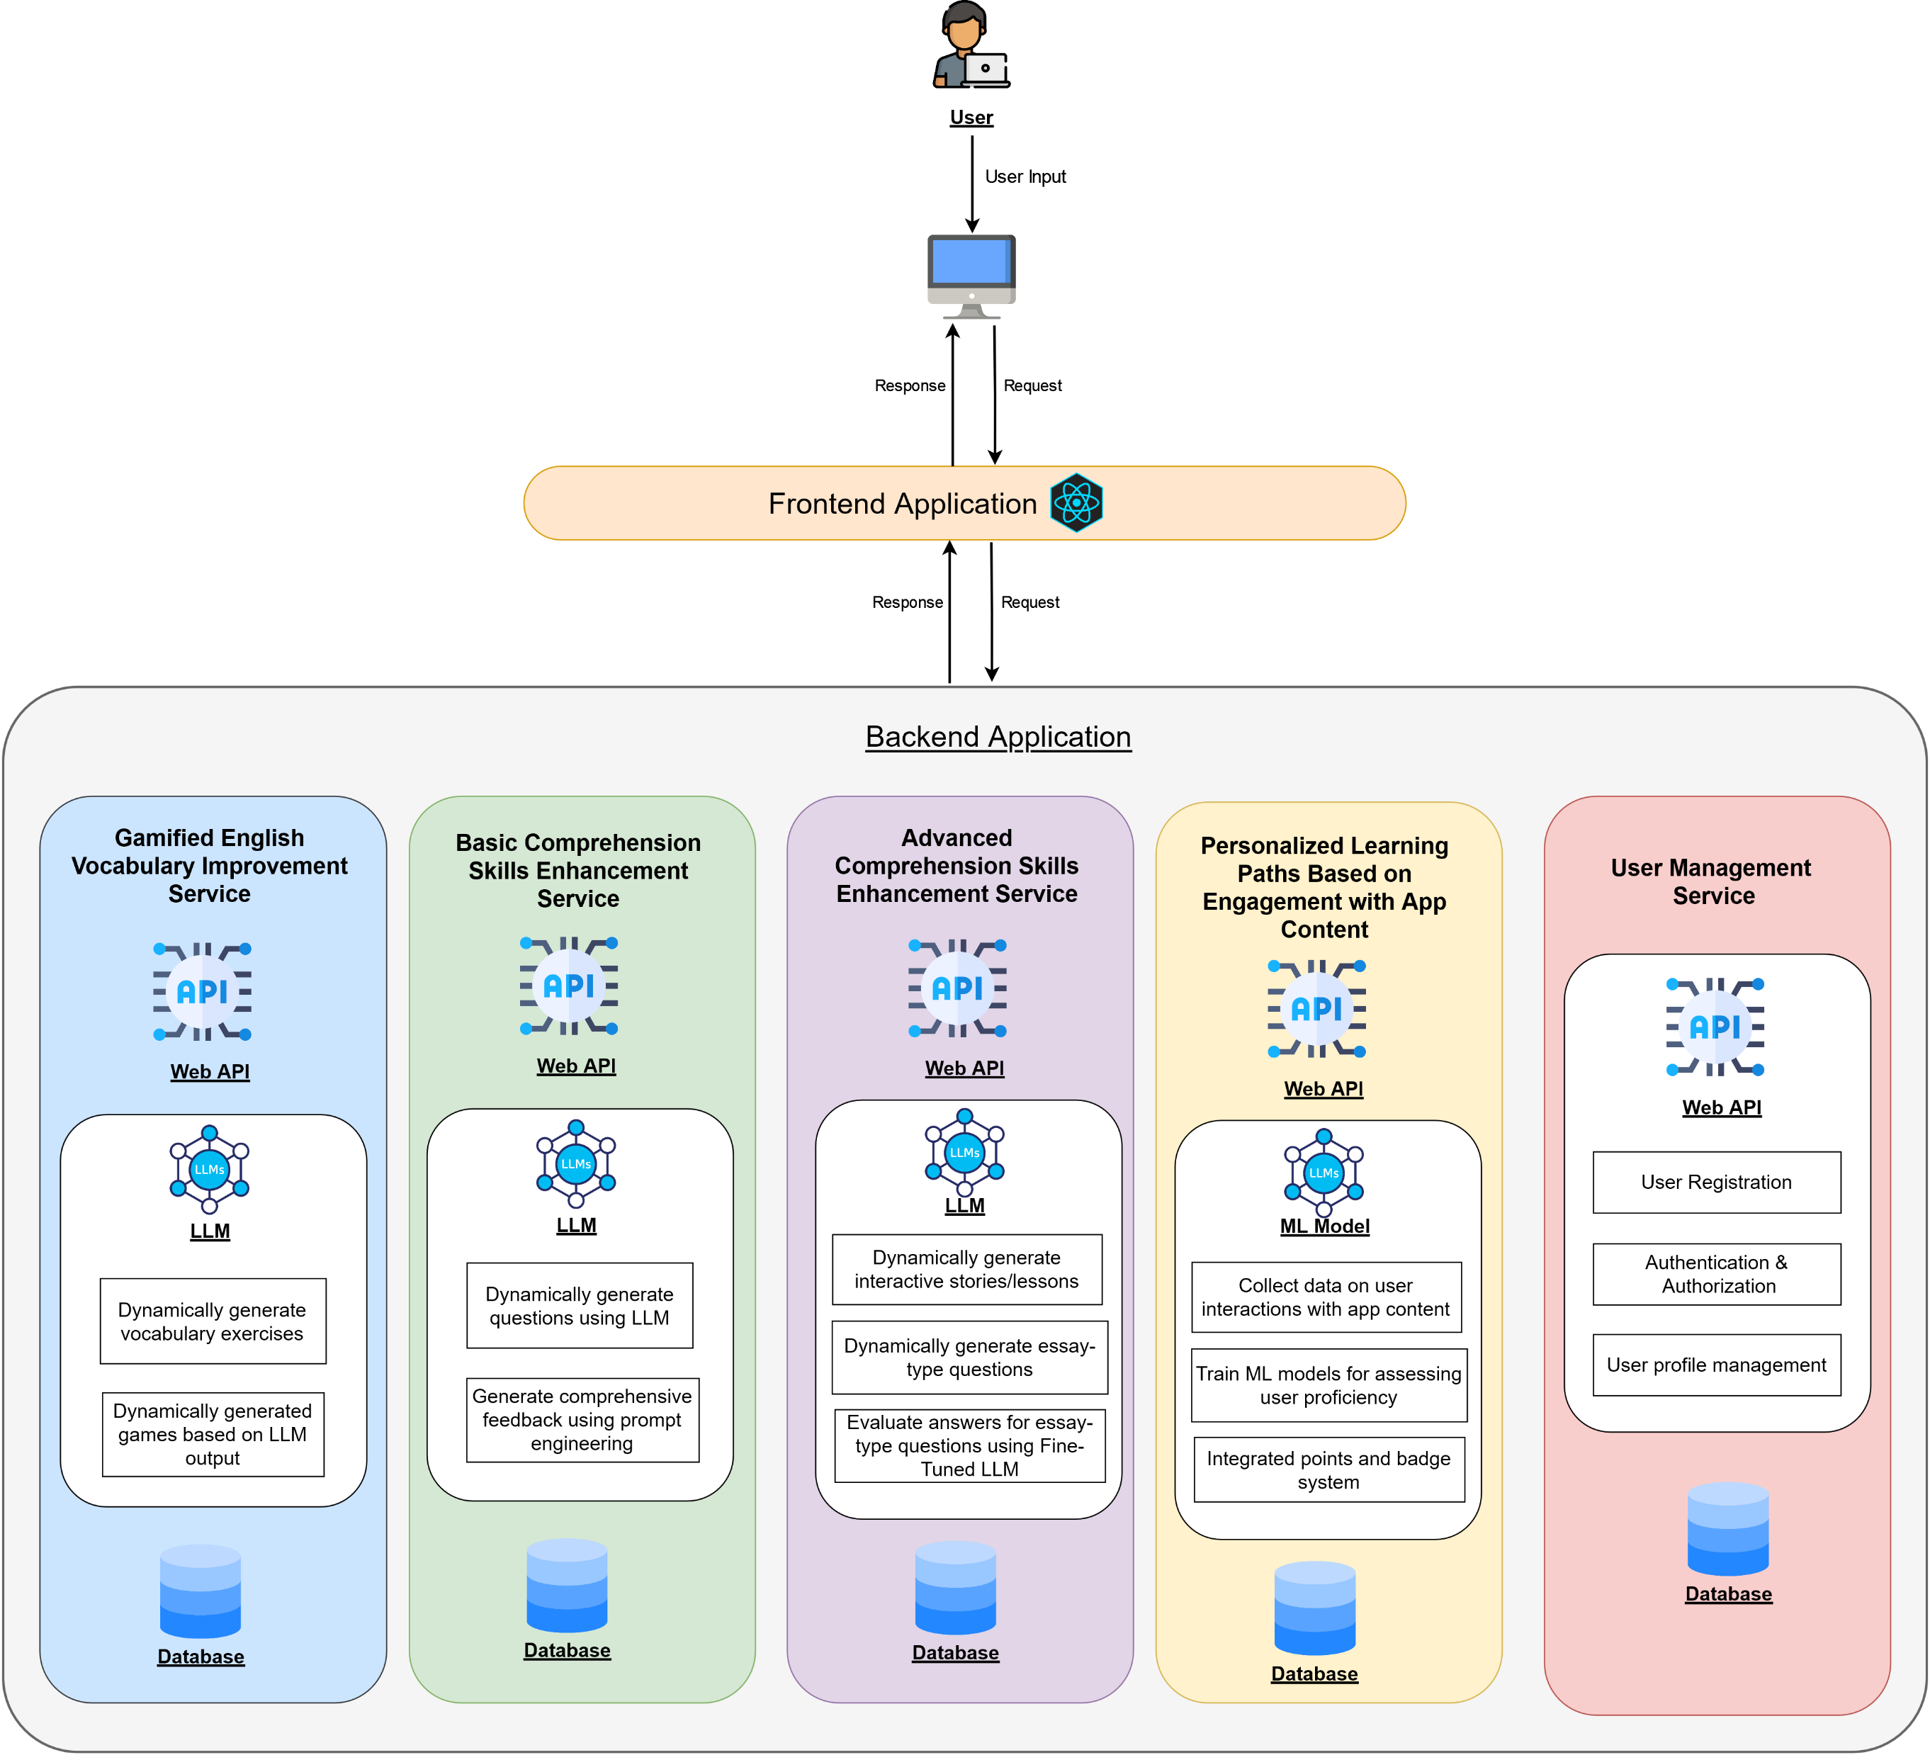
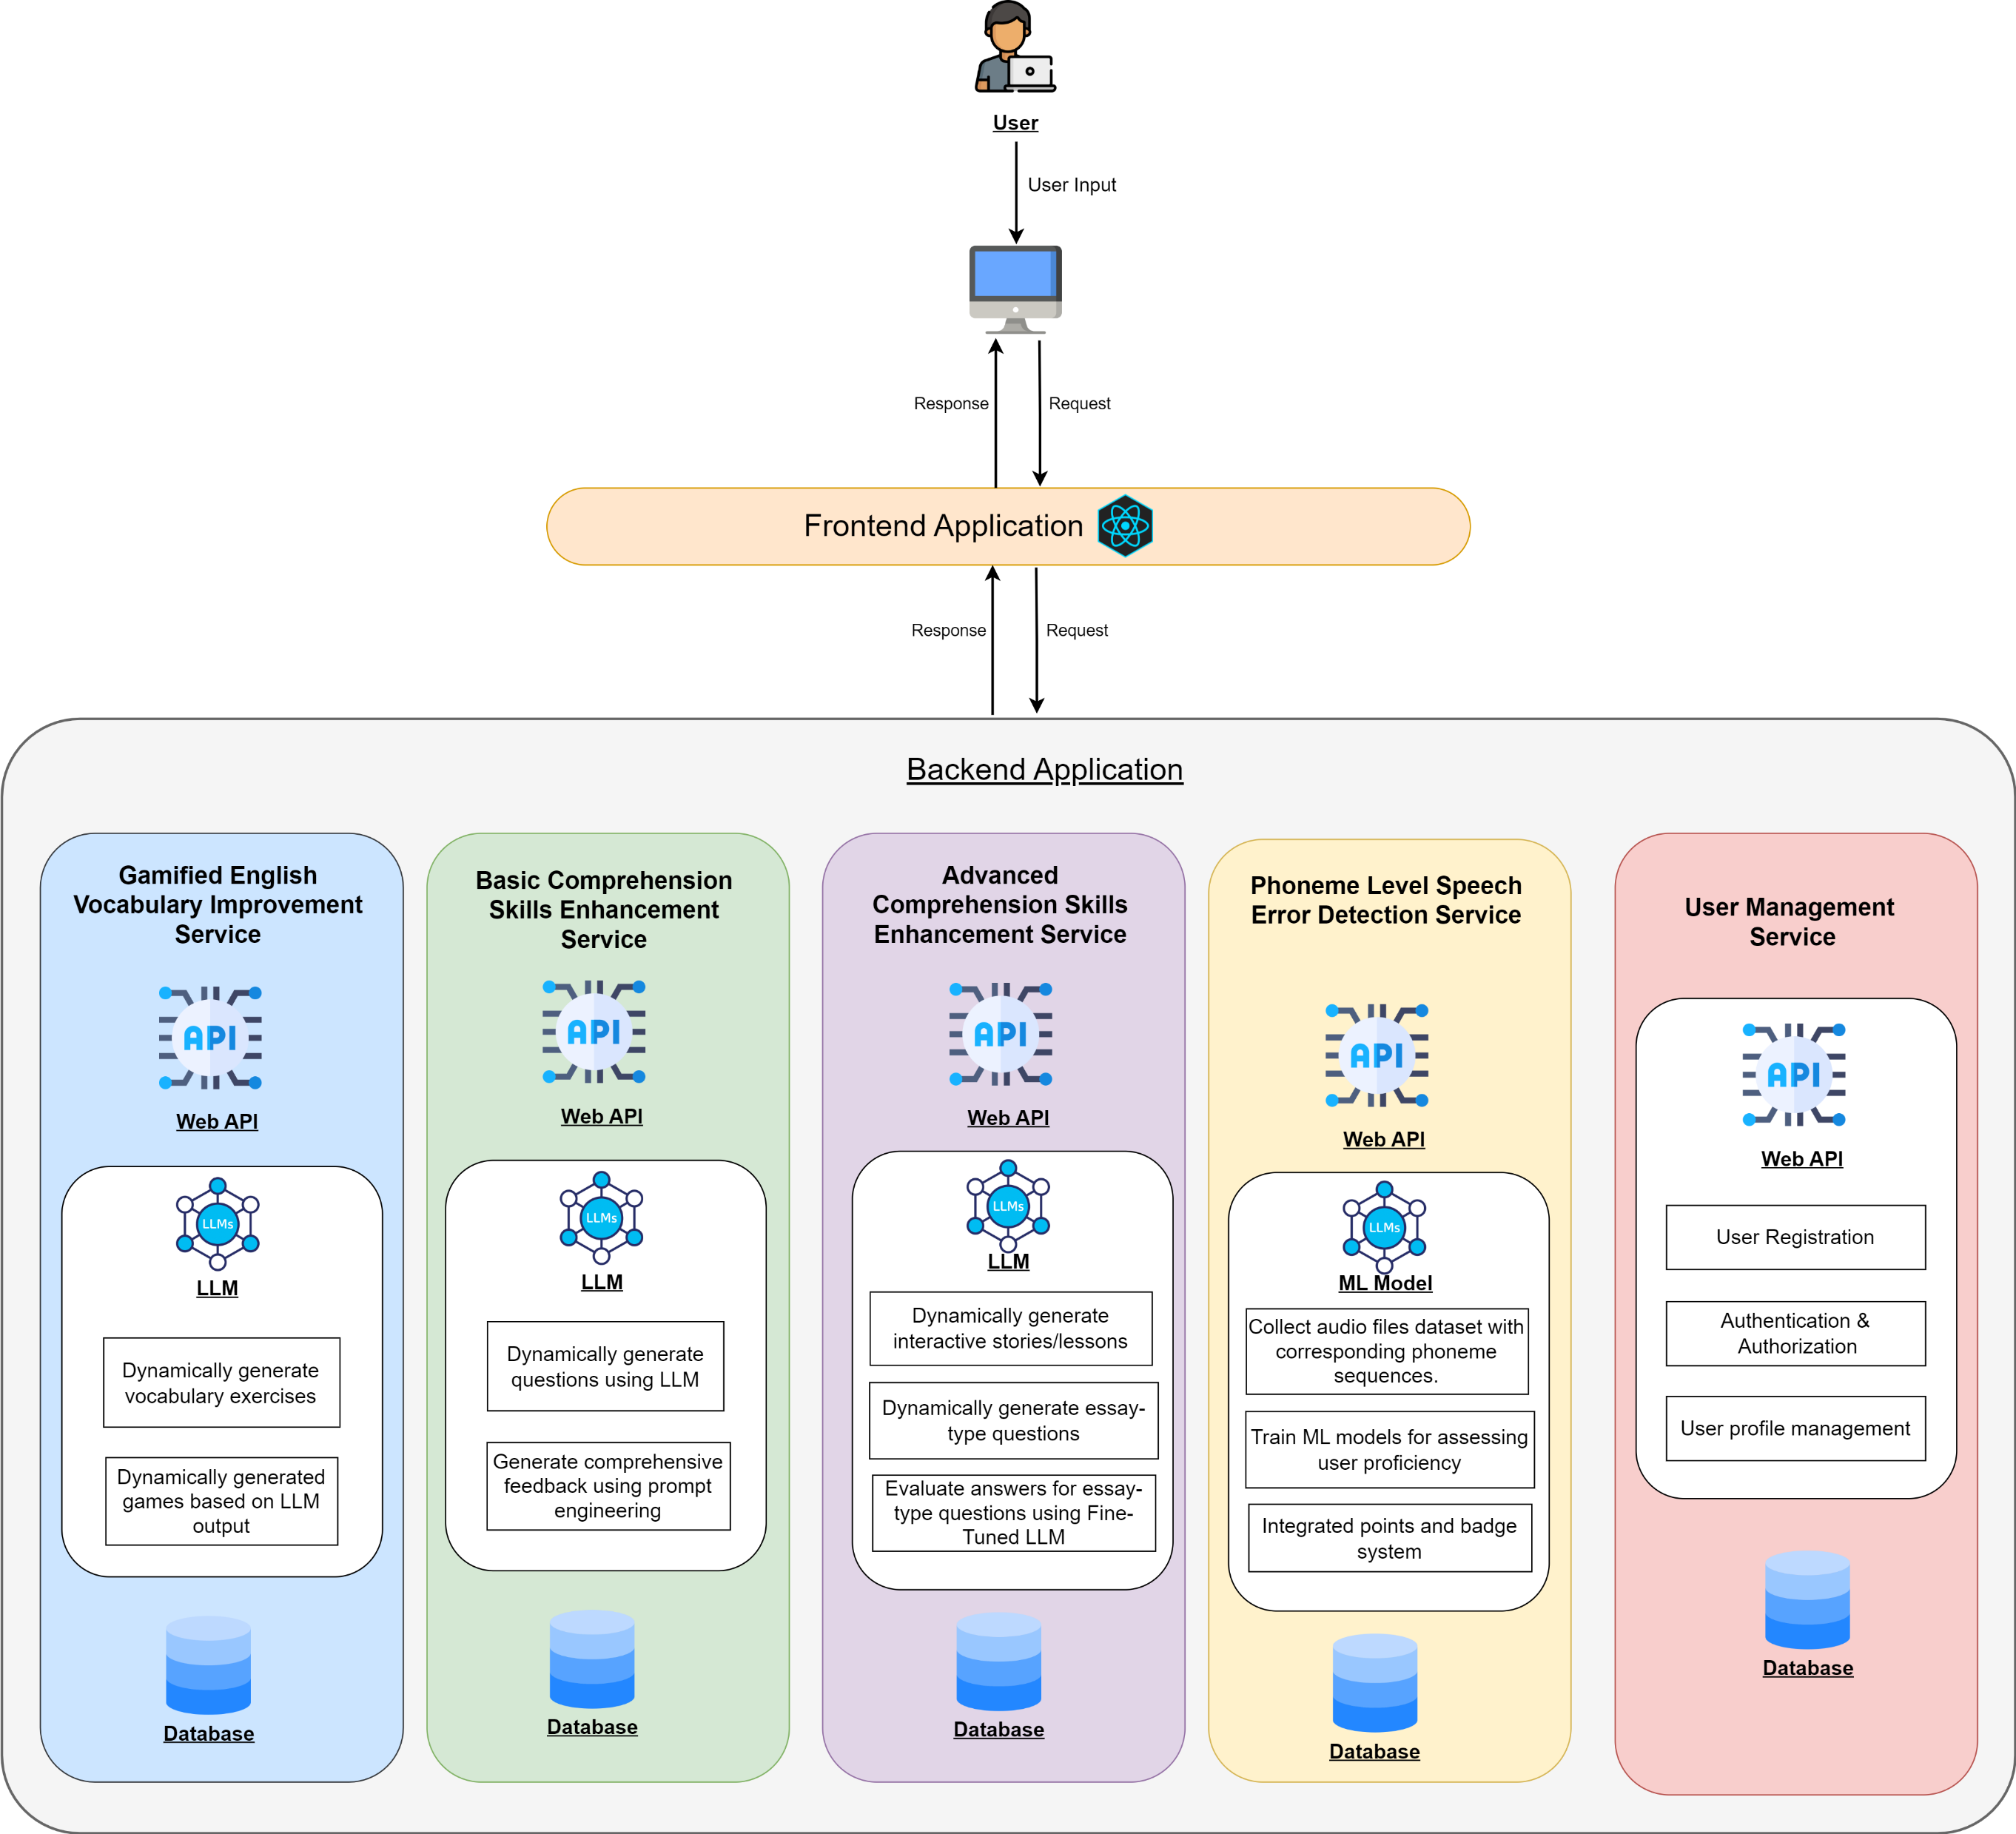
Overall System Diagram
3/18/2025
6
Notes:
This is a high level diagram of our proposed system. We intend use microservice architecture to implement our web application. In next sections you will hear more about these individual services.

Slide 7
AI-Powered Gamified English Vocabulary Improvement Module
IT21173790 – Sooriyaarachchi M.D.A
IT21173790 | Sooriyaarachchi M.D.A | 24-25J-027
3/18/2025
7

Slide 8




Background
Vocabulary is essential for effective communication and comprehension, especially in learning a second language like English.
Many educational tools rely on static vocabulary lists and traditional methods,
such as memorization and repetitive
exercises, which may not engage students effectively.
The module uses AI to create personalized exercises as a games based on students' vocabulary lists, catering to their specific learning levels and interests.
By providing dynamic and interactive content, the system offers a tailored and engaging learning experience, making vocabulary learning more enjoyable and effective.
IT21173790 | Sooriyaarachchi M.D.A | 24-25J-027
3/18/2025
8

Slide 9

Research Problem?
The challenge is to create a system that dynamically generates personalized educational exercises as games, based on a student’s inputted vocabulary list, thereby enhancing the learning experience..
Solving this issue will lead to a more engaging and personalized learning experience, ultimately improving vocabulary in language learning.
IT21173790 | Sooriyaarachchi M.D.A | 24-25J-027
3/18/2025
9

Slide 10
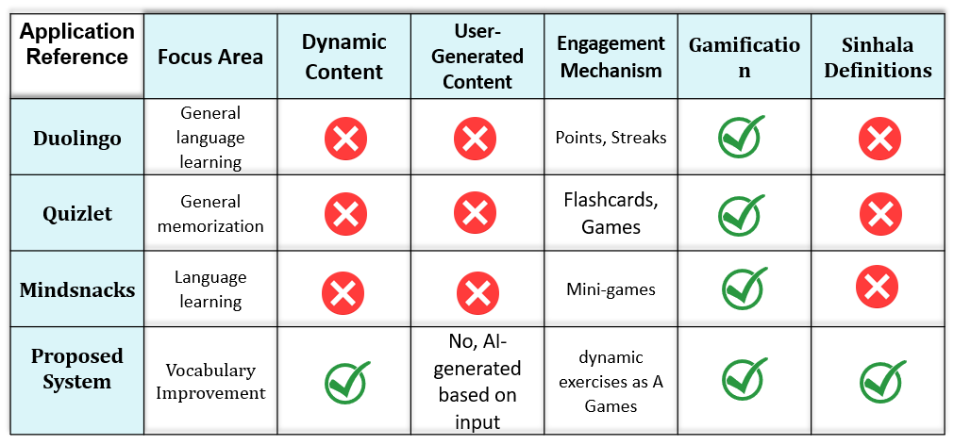
Research Gap
IT21173790 | Sooriyaarachchi M.D.A | 24-25J-027
3/18/2025
10

Slide 11



Specific and Sub Objectives
Identify and Analyze Student Vocabulary Needs
Generate Personalized and Adaptive Educational Games Using RAG
Implement Real-Time Feedback And Hints Using RAG
Specific Objective
To help high school students improve their English vocabulary and comprehension, we will create a module that generates interactive games and exercises based on the vocabulary words they provide
IT21173790 | Sooriyaarachchi M.D.A | 24-25J-027
3/18/2025
11

Slide 12
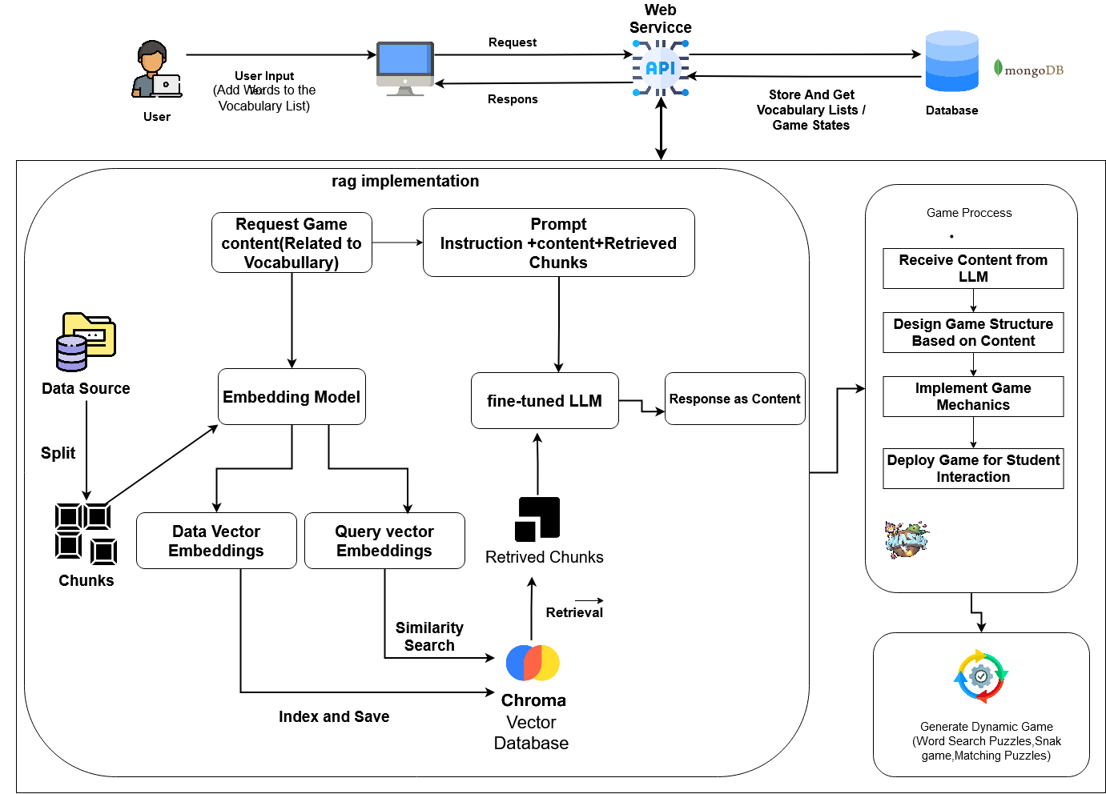






System Diagram
Word Association game
Taboo Chat
SpellMaster
IT21173790 | Sooriyaarachchi M.D.A | 24-25J-027
3/18/2025
12
Notes:
Personalization of Content Generation:
Ensure Accuracy of Word Definitions:
Chatbot Game:
Thease data set convert to chunks
After these chunks convert embedding usinng embedding model in hagging face
After thease numerical values stored in pinecone vector database
When system or user request things .it also convert to embedding and search similarity
After return similar values and this values combined with prompt and system request and input to llm
There 3 types of challenge games
One is word association challenge
select Which word shares a similar meaning or context given word
guess the word according to given hint and check word spellings
word describing game ,the player describe the word with out using word and related word

Slide 13






Technologies, Techniques, Algorithms
Technologies
React Js
Python and Fast Api
Phaser.js/HTML5 game framework
MongoDB
Pinecone Vector DB
Lang Chain Framework
Data Embedding Model
Techniques
Prompting techniques
Data embedding
Algorithms
Game Mechanics
IT21173790 | Sooriyaarachchi M.D.A | 24-25J-027
3/18/2025
13

Slide 14
System, Personal, and Software Specification Requirements
Software Requirements
React Js
Node JS and Express JS
Python and Django
Unity and JS
MongoDB
Docker
Kubernetes
Functional Requirements
The system should allow students to input and manage their vocabulary lists effortlessly
The System should be generate Hints for the Words if student struggle
The System Should be Generate Personalize Gaming Content
The System should be generate accurate content
Non-Functional Requirements
The user interfaces should be user friendly to the user.
Users can trust the application's reliability and consistent performance.
The application is expected to produce highly accurate results.
The generated results should be more efficient and effective.
Personal Requirements
Help Of English Teachers
IT21173790 | Sooriyaarachchi M.D.A | 24-25J-027
3/18/2025
14

Slide 15
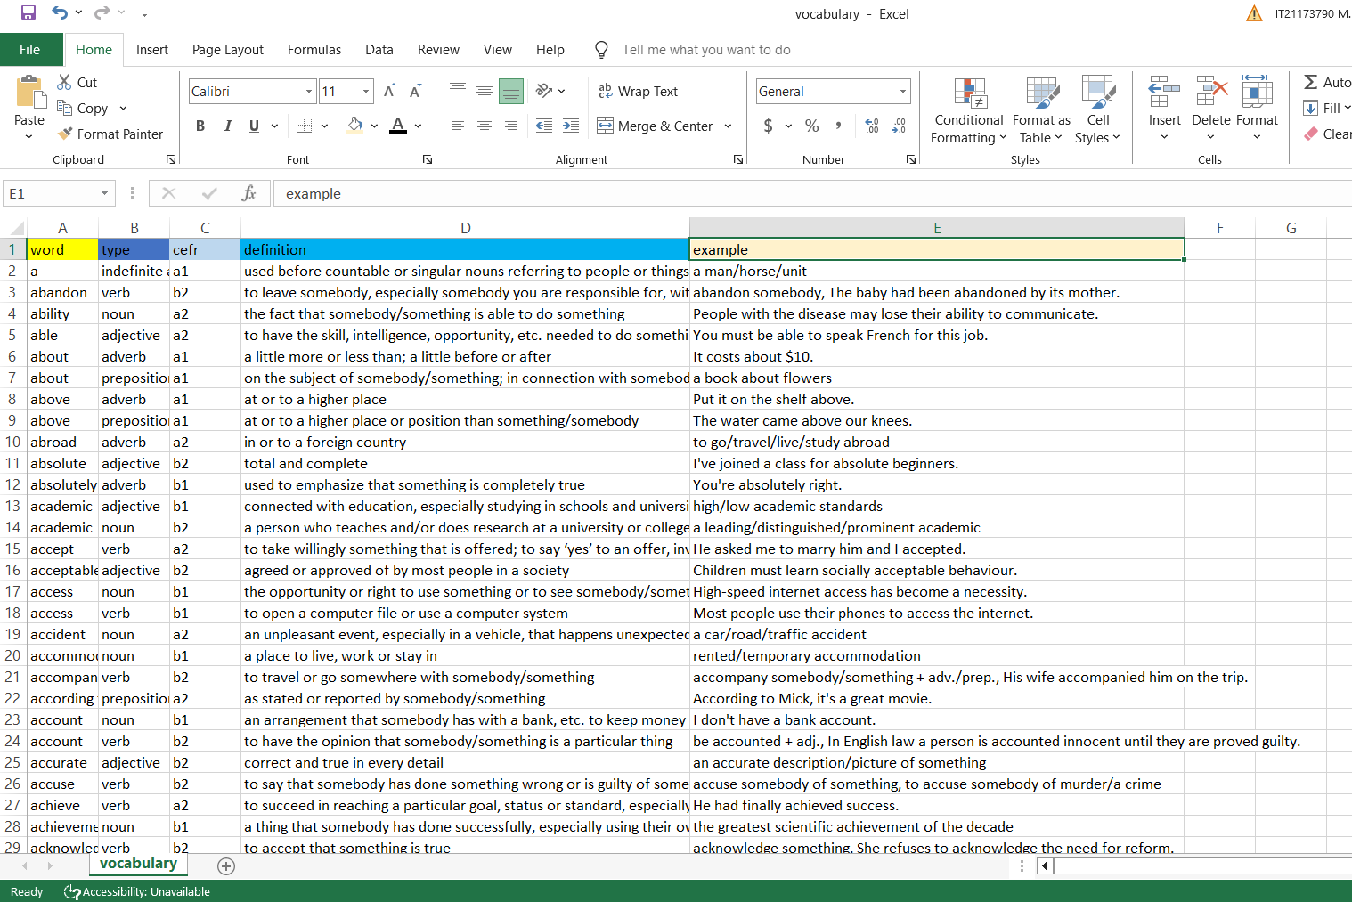
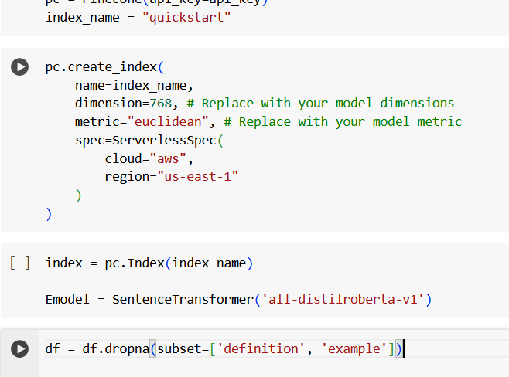
RAG Implementation Work Flow Data Collection and Pre-processing
IT21173790 | Sooriyaarachchi M.D.A | 24-25J-027
3/18/2025
15
Notes:
I prepared data collection as a around 7000 word with definitions with examples

Slide 16
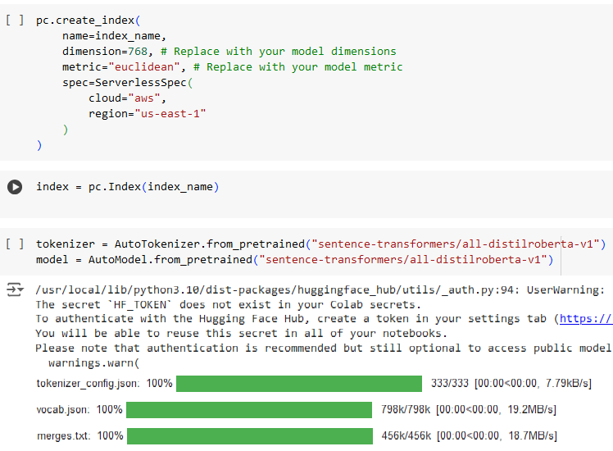
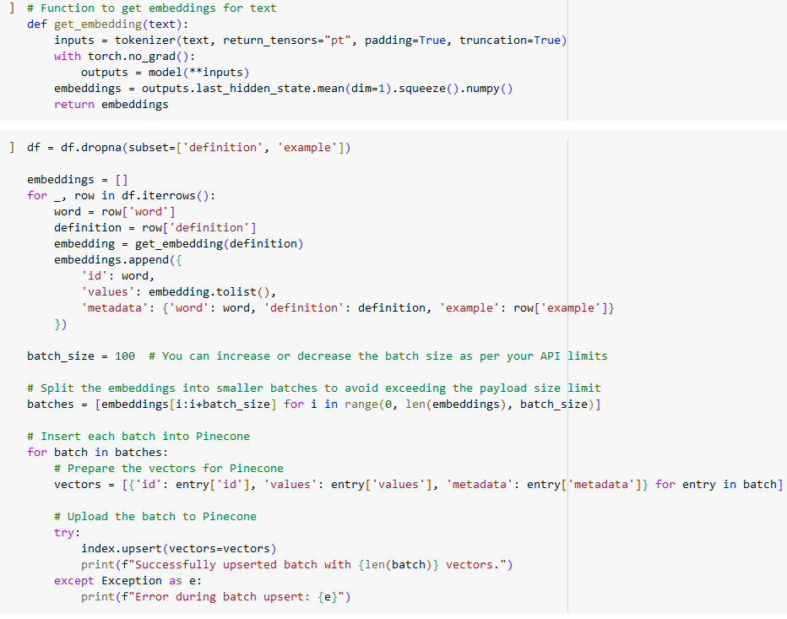
RAG Implementation Work Flow Embedding ​Creation
IT21173790 | Sooriyaarachchi M.D.A | 24-25J-027
3/18/2025
16

Slide 17
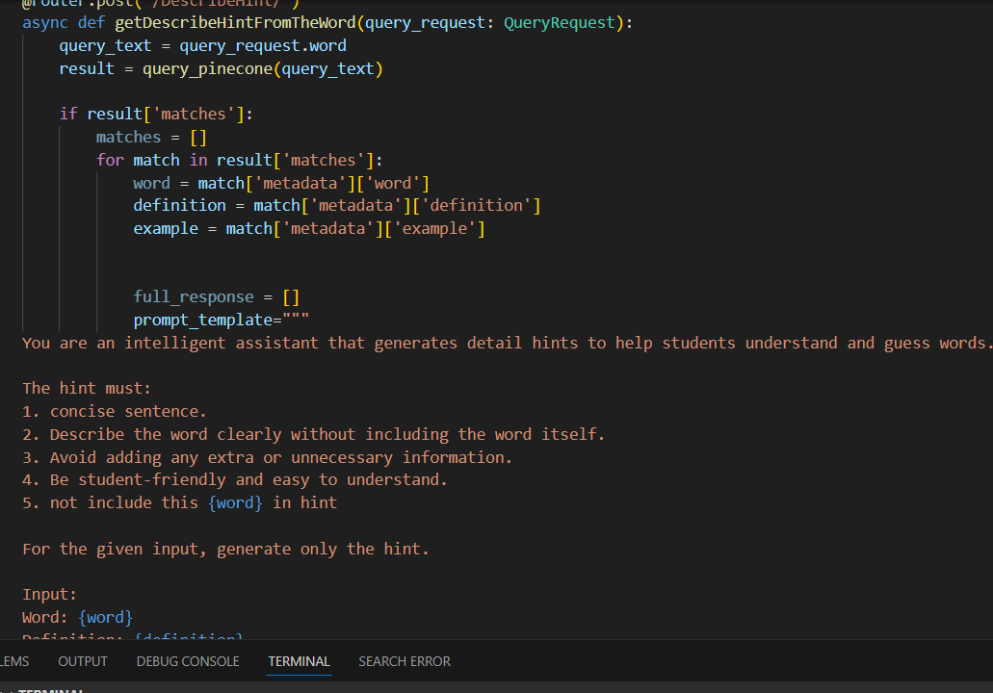
RAG Implementation Work Flow RAG system Integrate with Fast API
IT21173790 | Sooriyaarachchi M.D.A | 24-25J-027
3/18/2025
17

Slide 18
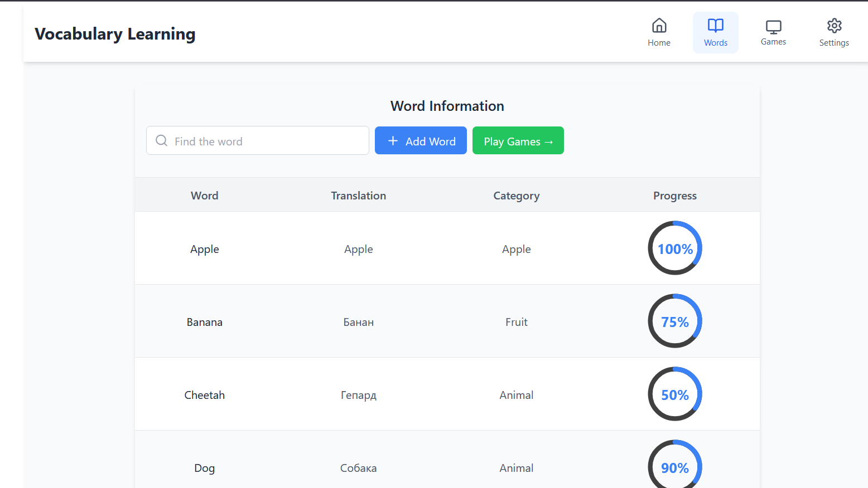
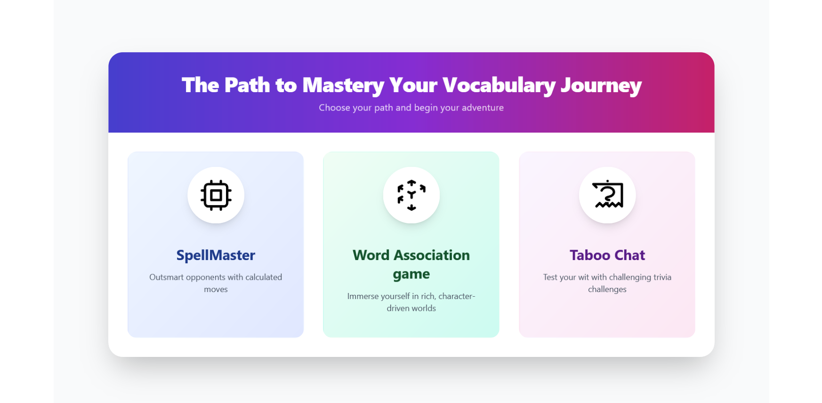
Web Application Frontend Implementation
IT21173790 | Sooriyaarachchi M.D.A | 24-25J-027
3/18/2025
18

Slide 19
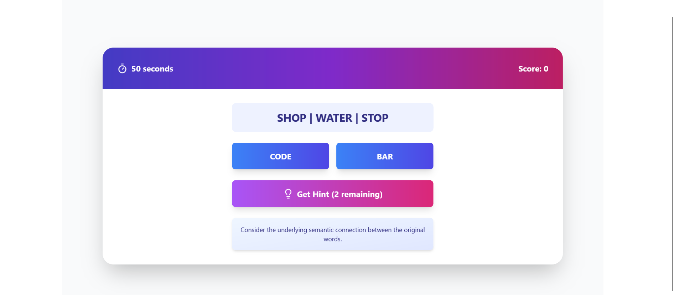
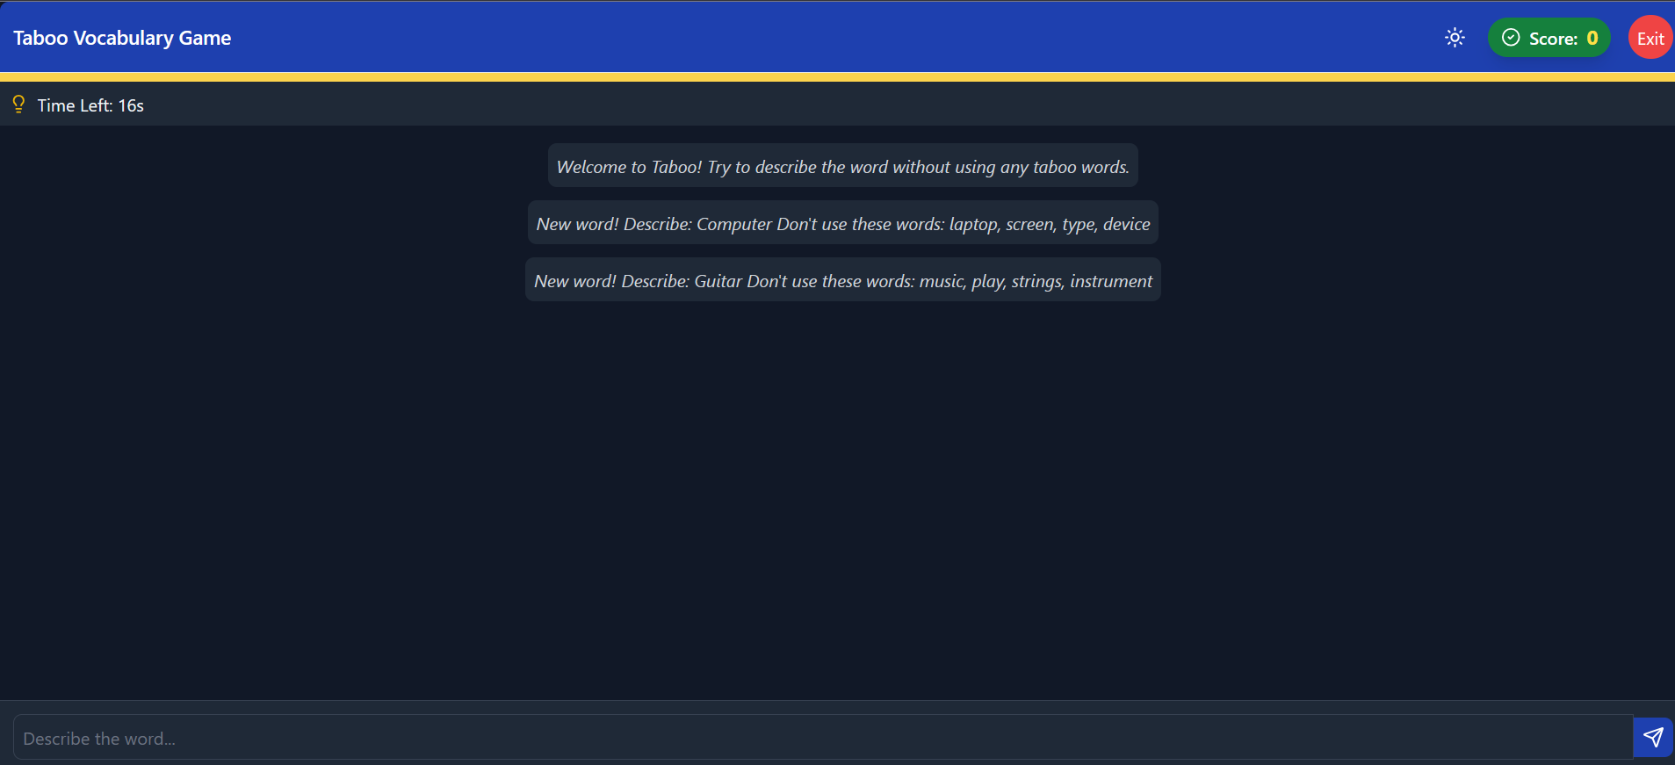
Web Application Frontend Implementation
IT21173790 | Sooriyaarachchi M.D.A | 24-25J-027
3/18/2025
19
Notes:
Time spent on each round.
How often they need clarification questions.
Whether they are quick to guess or take their time.
also get user preferences
Tracking Conversations: LangChain can store user queries and AI responses in a database or file system (like SQLite or PostgreSQL), allowing for easy retrieval of past conversations with metadata (e.g., timestamps, user IDs).

Slide 20
Completion of the components and Future Implementations
Completion of the Components
Analyzed Dataset and Create Rag system
Create Fast Api Backend For Generate Gaming Content Through Rag System
Design and Implemented UI of the web application frontend
Future Implementations
Testing Accuracy Of the Rag Implementation
Personalize The User Gaming Path
Integrate frontend and Backend
IT21173790 | Sooriyaarachchi M.D.A | 24-25J-027
3/18/2025
20
Notes:
Time spent on each round.
How often they need clarification questions.
Whether they are quick to guess or take their time.
also get user preferences
Tracking Conversations: LangChain can store user queries and AI responses in a database or file system (like SQLite or PostgreSQL), allowing for easy retrieval of past conversations with metadata (e.g., timestamps, user IDs).

Slide 21
References
[1] P. Dillenbourg, M. Jermann, and S. Gurtner, "Introduction to dual and interactive learning," New Learning Models, vol. 5, no. 3, pp. 45-55, 2006.
[2] T. B. Brown et al., "Language Models are Few-Shot Learners," arXiv preprint arXiv:2005.14165, 2020.
[3] A. K. Dey and G. D. Abowd, "Towards a Better Understanding of Context and Context-Awareness," Proc. HUC '99, 1999, pp. 304-307.
[4] N. G. Nagy, P. W. Herman, and R. C. Anderson, "Learning Words From Context," Reading Research Quarterly, vol. 20, no. 2, pp. 233-253, 1985.
21
3/18/2025
IT21173790 | Sooriyaarachchi M.D.A | 24-25J-027
3/18/2025
21

Slide 22
Demo
IT21173790 | Sooriyaarachchi M.D.A | 24-25J-027
3/18/2025
22

Slide 23
Basic Comprehension Skills Enhancement Module
IT21158322 – W. G. B. Senanayake
IT21158322 | W. G. B. Senanayake | 24-25J-027
3/18/2025
23

Slide 24
Background
Traditional educational tools for reading comprehension often lack the capability to dynamically generate quizzes and reading materials tailored to individual student needs.
Existing systems provide generic feedback, which may not address specific areas where a student needs improvement.
Leveraging AI technologies, particularly Large Language Models (LLMs) and prompt engineering, offers the potential to create personalized and dynamic educational experiences
IT21158322 | W. G. B. Senanayake | 24-25J-027
3/18/2025
24

Slide 25
Research Problem?
How can we leverage AI technologies, Large Language Models (LLMs) to dynamically generate quizzes and reading paragraphs
IT21158322 | W. G. B. Senanayake | 24-25J-027
3/18/2025
25

Slide 26
Research Gap
Feature/Tool | Khan Academy | Quizlet | Duolingo | AceReader Pro | Proposed System (Basic Comprehension Enhancement Module)
Dynamic Quiz Generation | No | No | Yes | No | Yes
Personalized Feedback | Yes | No | Limited | No | Yes
Dynamic Paragraph Generation | No | No | No | No | Yes
Prompt Engineering for Feedback | No | No | No | No | Yes
Comprehensive Feedback for Each Answer | Limited | No | Limited | No | Yes
IT21158322 | W. G. B. Senanayake | 24-25J-027
3/18/2025
26

Slide 27
Research Objectives
Main Objective:
Integrate AI-based technologies to generate dynamic quizzes
Sub Objectives:
Develop a system that generates basic level quizzes (MCQ, Drag & Drop, Fill in the blanks, True/False).
Dynamically generate reading paragraphs tailored to different comprehension levels.
IT21158322 | W. G. B. Senanayake | 24-25J-027
3/18/2025
27

Slide 28
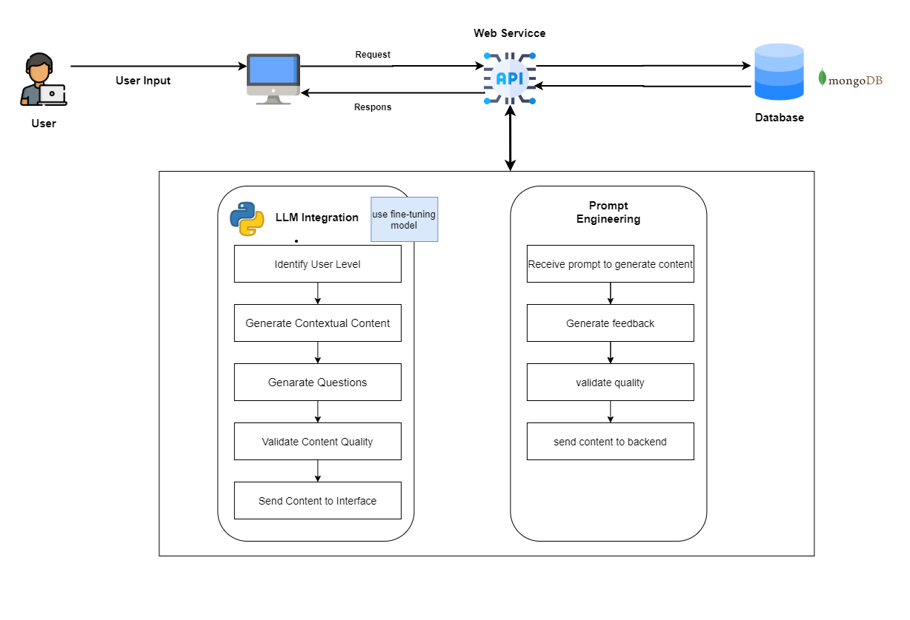
System Design
IT21158322 | W. G. B. Senanayake | 24-25J-027
3/18/2025
28

Slide 29
Tools & Technologies
Frontend - JavaScript & React
Backend - Python & Django
Database - PostgresSQL
Hosting – Azure
CI/CD – GitHub, Docker, Kubernetes content.
Large Language Models- llama 3-7b instruct
Prompt Engineering for refining AI-generated content.
IT21158322 | W. G. B. Senanayake | 24-25J-027
3/18/2025
29

Slide 30
Software Specification Requirements
Functional:
The system should be able to generate multiple types of quizzes (MCQ, Drag & Drop, Fill in the blanks, True/False) based on student proficiency levels.
The system should generate reading paragraphs tailored to different comprehension levels of students.
Non Functional: Scalability , Performance, Security, Usability
IT21158322 | W. G. B. Senanayake | 24-25J-027
3/18/2025
30

Slide 31
Other Requirements
System:
High-performance servers to handle AI computations.
Secure databases for storing user data and quizzes.
Personal:
Expertise in AI/ML, backend development, and data security
Help Of English Teachers
IT21158322 | W. G. B. Senanayake | 24-25J-027
3/18/2025
31

Slide 32
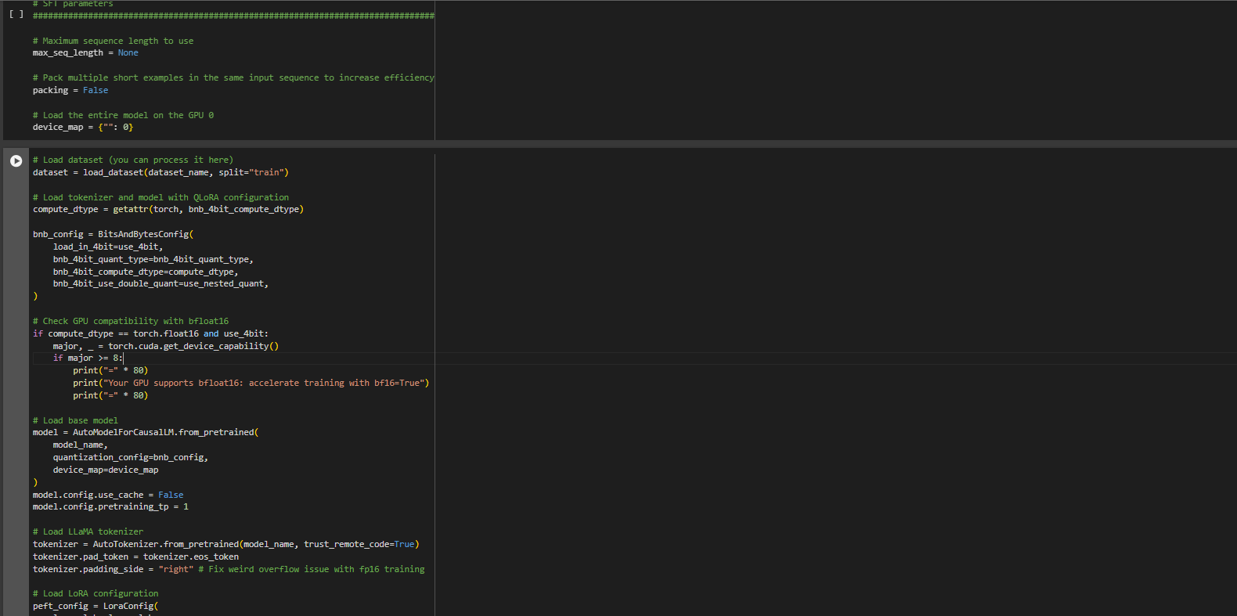
Implementation
Fine tune llama 3 model using Google Colab NoteBook
To complete
Personalize path for each user

Slide 33
References
[1] AI-Driven Feedback Mechanisms in E-Learning
Yang, S. J., Chen, I. Y., Kinshuk, & Chen, N. S. (2007). Enhancing learning performance with personalized feedback in web-based learning environments. Interactive Learning Environments, 15(3), 327-341.
[2] Prompt Engineering for Effective AI Communication
Brown, T. B., Mann, B., Ryder, N., Subbiah, M., Kaplan, J., Dhariwal, P., ... & Amodei, D. (2020). Language models are few-shot learners. arXiv preprint arXiv:2005.14165.
[3] Large Language Models: Radford, A., Wu, J., Child, R., Luan, D., Amodei, D., & Sutskever, I. (2019). Language models are unsupervised multitask learners. OpenAI Blog, 1(8), 9.
[4] Quizlet: Quizlet. (n.d.). Retrieved from https://quizlet.com/
33
3/18/2025
IT21158322 | W. G. B. Senanayake | 24-25J-027
3/18/2025
33

Slide 34
Advanced Comprehension Skills Enhancement Module
IT21118340 – S. A. D. S. Kumarathunga
IT21118340 | S. A. D. S. Kumarathunga | 24-25J-027
3/18/2025
34
Notes:
Hi everyone, My name is S. A. D. S. Kumarathunga. I’m responsible for ..

Slide 35


Background
What are Advanced Comprehension Skills?
Understanding the implied meaning of the text.
Ability to evaluate and analyze given text.
Skills:
Making inferences and deductions,
Connecting different parts of the text
Applying background knowledge
Finding the main idea, important facts, and supporting details
Summarizing
Generating and Asking Questions
IT21118340 | S. A. D. S. Kumarathunga | 24-25J-027
3/18/2025
35
Notes:
What exactly are advanced comprehension skills?
They go beyond simply understanding the words on a page.
Advanced comprehension involves grasping the implied meaning of a text, evaluating and analyzing the content, and applying critical thinking.
These skills include making inferences and deductions, connecting different parts of the text, applying background knowledge, identifying the main idea, important facts, and supporting details, summarizing, and generating as well as asking insightful questions.
Developing these skills is essential for deep, meaningful engagement with any text.

Slide 36

Research Problem?
Lack of dynamically adaptable exercises.
Lack tools to provide assessments for essay-type questions that typically require human evaluation.
IT21118340 | S. A. D. S. Kumarathunga | 24-25J-027
3/18/2025
36
Notes:
One challenge in English education today is the lack of dynamically adaptable content that can adjust to the varying needs of learners.
Also, another significant challenge is that, there are no tools capable of evaluating answers for essay-type questions.
Which means students have to wait for their English teacher to evaluate their work and provide feedback, which is time consuming process
Our proposed system intend to address these gaps and create more time-effective and personalized learning experiences.

Slide 37

Research Gap
Apps | Dynamic Content | Evaluate answers without human involvement | Provide feedback without human involvement
Generic Reading Apps
Duolingo |  | Only offer MCQ based questions | Limited feedback
AceReader Pro
ReadyRead
Smart AI Reading Assistant for Reading Comprehension
Proposed System
IT21118340 | S. A. D. S. Kumarathunga | 24-25J-027
3/18/2025
37
Notes:
This is a table of exiting tools.
As u can see most of them do not offer personalized content,
Answer evaluation nor comprehensive feedback.

Slide 38
Research Objectives
Main Objective: Provide a platform to improve advanced comprehension skills such as Sequencing, Summarizing, Self-questioning
Sub Objectives:
Implement Agentic RAG workflow to generate dynamic paragraphs and exercises
Implement Agentic RAG workflow to accurately evaluate answers and provide feedback without human involvement
Develop the most suitable prompts to generate dynamic exercises, evaluate answers and provide feedback.
IT21118340 | S. A. D. S. Kumarathunga | 24-25J-027
3/18/2025
38
Notes:
The main objective of my research is to provide a platform that enhances advanced comprehension skills, such as sequencing, summarizing, and self-questioning.
To achieve this, I have set several key sub-objectives:
fine-tuning a large language model to generate dynamic content,
refining the model to accurately evaluate answers without human involvement,
and developing the most effective prompts to ensure both content generation and answer evaluation

Slide 39
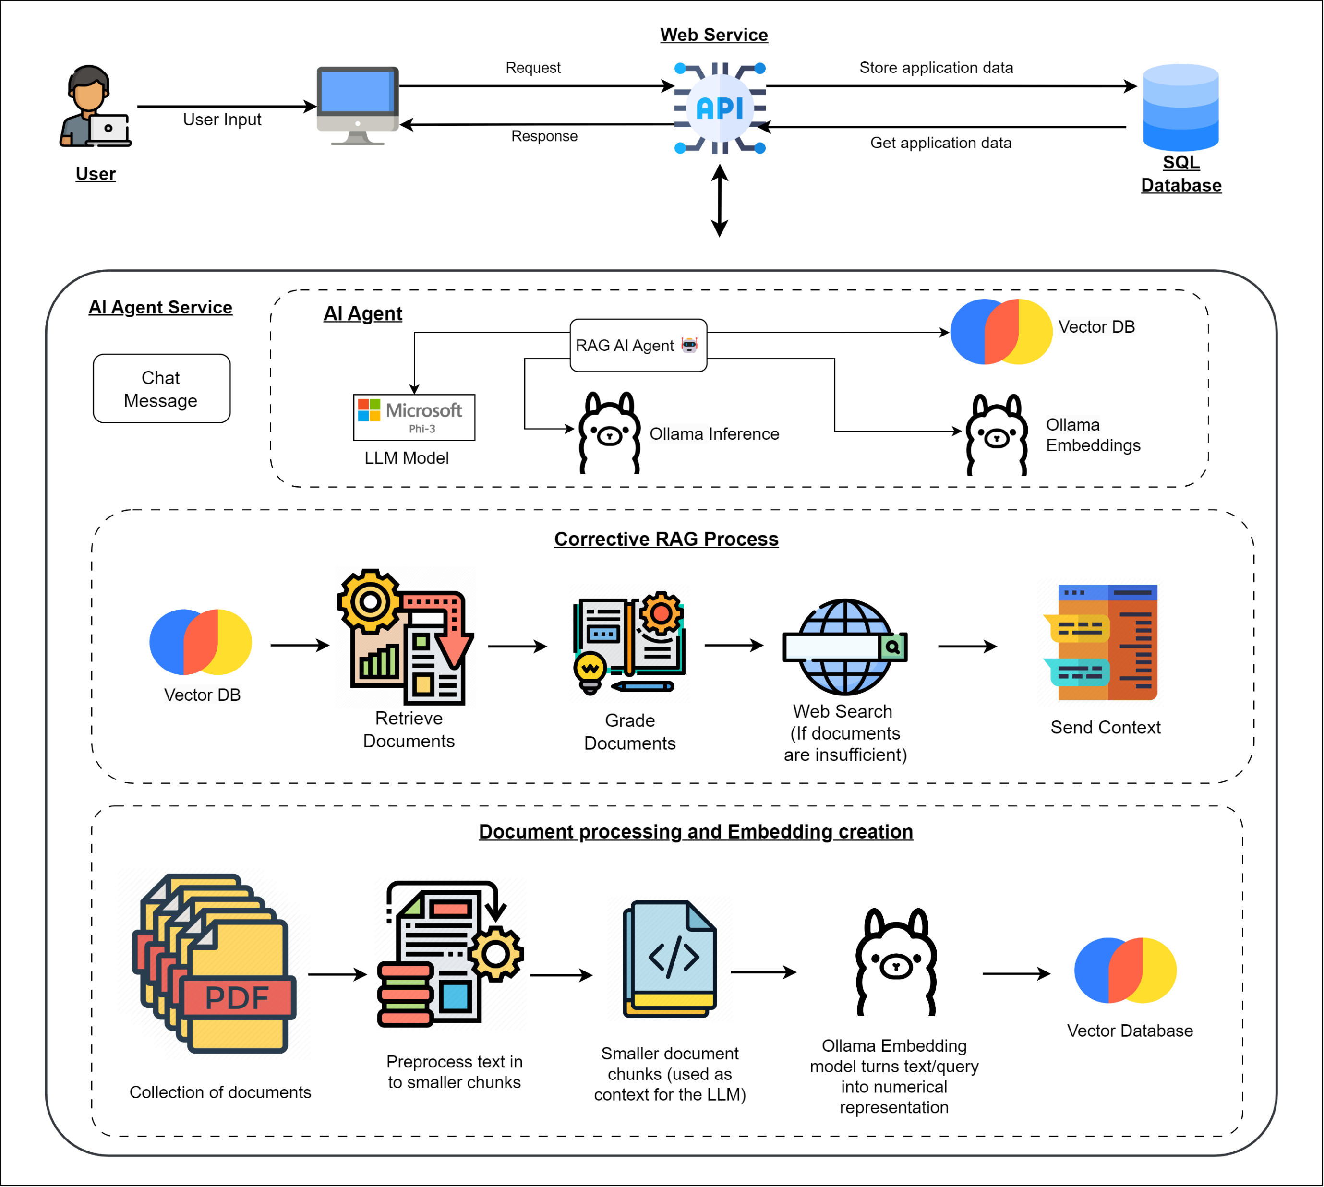
System Diagram
IT21118340 | S. A. D. S. Kumarathunga | 24-25J-027
3/18/2025
39
Notes:
The proposed service consist of three modules.
Interactive lesson generation
Dynamic quiz generation
Answer evaluation

Slide 40



Tools & Technologies
Frontend – StreamLit
Backend - Python & LangChain
Database – Chroma DB
LLM Model – Phi3 Mini
Prompt Engineering Techniques
Zero-Shot Prompting, Few-Shot Prompting
RAG Techniques – Corrective RAG
AI Agent – Tool Calling, ReAct
IT21118340 | S. A. D. S. Kumarathunga | 24-25J-027
3/18/2025
40
Notes:
This is a list of tools and technologies I intent use.
For the frontend, I employ JavaScript and React, while the backend is powered by Python and Django.
Data is managed using Postgres SQL,
Fine-tuned Llama LLM model combined with prompt engineering is used for advanced language processing.
Fine-tuning process is conducted using Vertex AI
Web Hosting is managed on Azure, while models are hosted in Hugging Face

Slide 41
Project Completion [60%]
Prompt Engineering
Selecting Methodology: AI Agent vs RAG vs Agentic RAG
AI Agent
Selecting LLM Model & Inference Engine: Phi3, Ollama
Selecting Architecture & Patterns: ReAct, Tool Calling
RAG Workflow
Selecting Embedding Model & Vector DB: Ollama, ChromaDB
Embedding Creation Pipeline
Corrective RAG
UI Design (Working progress)
IT21118340 | S. A. D. S. Kumarathunga | 24-25J-027
3/18/2025
41
Notes:
This is a list of tools and technologies I intent use.
For the frontend, I employ JavaScript and React, while the backend is powered by Python and Django.
Data is managed using Postgres SQL,
Fine-tuned Llama LLM model combined with prompt engineering is used for advanced language processing.
Fine-tuning process is conducted using Vertex AI
Web Hosting is managed on Azure, while models are hosted in Hugging Face

Slide 42
Prompt Engineering
Prompt engineering is the process of crafting input prompts to optimize the output of large language models (LLMs). It involves designing clear, specific, and effective instructions to guide the model towards generating more accurate, relevant, and useful responses.
Importance in Optimizing LLM Outputs:
Improves Response Quality
Enhances Efficiency
Increases Flexibility
Optimizes Resource Usage
IT21118340 | S. A. D. S. Kumarathunga | 24-25J-027
3/18/2025
42
Notes:
Using PE, We can Improves Response Quality, Enhances Efficiency, Increases Flexibility, Optimizes Resource Usage

Slide 43
Prompt Optimization Techniques Used
Question Generation Prompt:
“You are an AI teacher tasked with creating essay questions from the given paragraph. Purpose of the question is to measure student understanding of the paragraph. Aim for a maximum word limit of 50 words per question. Only create one question. \nParagraph: {paragraph}”
Role-based Prompting: Assigning a Role to the Model
Zero-Shot Prompting: Expecting Model Inference Without Examples
Guided Prompting: Narrowing the Focus
IT21118340 | S. A. D. S. Kumarathunga | 24-25J-027
3/18/2025
43
Notes:
Proposed system is designed with key functional goals in mind.
It will dynamically generate content tailored to the user's interests and skill level,
Accurately evaluate user responses without human intervention,
Provide extensive feedback on their answers.
On the non-functional side, focus is on ensuring accuracy, high performance, availability, and user-friendliness

Slide 44
Prompt Optimization Techniques Used
Feedback Generation Prompt:
“You are a helpful and kind AI teacher who provides detailed, helpful and constructive feedback about the student's answer. Max word limit 150. Keep the feedback simple, concise, and within the max word limit. Here is the question, context paragraph for the question, and the student's answer for the question. Purpose of this question is to evaluate student comprehension of the given context paragraph. First validate every single word and sentence in the student's answer by comparing it with the given context paragraph and give detailed, helpful and constructive feedback for each sentence. Always clearly mention if the overall answer is correct or incorrect in the beginning of the response.
Role-based Prompting: Assigning a Role to the Model
Chain-of-Thought Prompting: Step-by-Step Reasoning
Progressive Prompting: Gradually Building the Response
IT21118340 | S. A. D. S. Kumarathunga | 24-25J-027
3/18/2025
44
Notes:
Proposed system is designed with key functional goals in mind.
It will dynamically generate content tailored to the user's interests and skill level,
Accurately evaluate user responses without human intervention,
Provide extensive feedback on their answers.
On the non-functional side, focus is on ensuring accuracy, high performance, availability, and user-friendliness

Slide 45
AI Agent vs RAG vs Agentic RAG
Feature | AI Agent | RAG | Agentic RAG
Core Functionality | General-purpose | Combines retrieval and generation | Specialized problem-solving
Autonomy | User-driven interaction | Static queries | Adaptive and dynamic
Memory | Persistent knowledge | Limited contextual memory | Adaptive contextual memory
Data Retrieval | External dependencies | Built-in retrieval system | Native retrieval with API integration
Reasoning | Predefined workflows | Limited dynamic reasoning | Multi-step reasoning
Adaptability | Limited flexibility | Static operations | Highly adaptable to new information
IT21118340 | S. A. D. S. Kumarathunga | 24-25J-027
3/18/2025
45
Notes:
Overall, Agentic RAG is considered better because: It combines the strengths of RAG (information retrieval and generation) with AI agent capabilities (adaptability and reasoning).

Slide 46
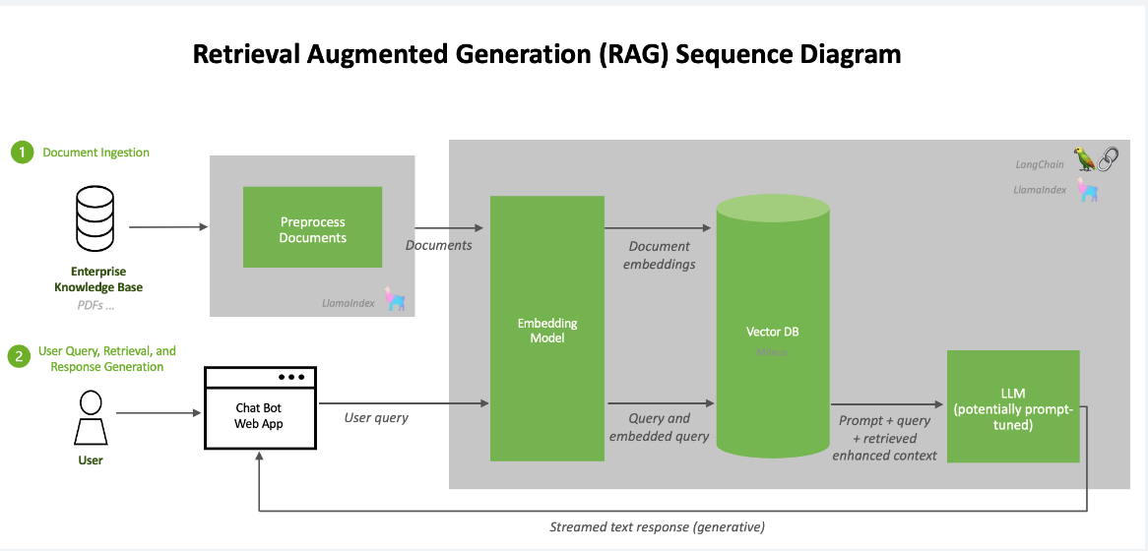
RAG Workflow
RAG stands for Retrieval-Augmented Generation. It's an AI technique that combines information retrieval with text generation to produce coherent and contextually relevant outputs. The RAG workflow typically includes embedding creation, and a generation phase..
Embedding : Ollama
Open-source platform.
Cost free.
Vector database: Chroma DB
AI-native
Open-source.
Cost free.
IT21118340 | S. A. D. S. Kumarathunga | 24-25J-027
3/18/2025
46

Slide 47
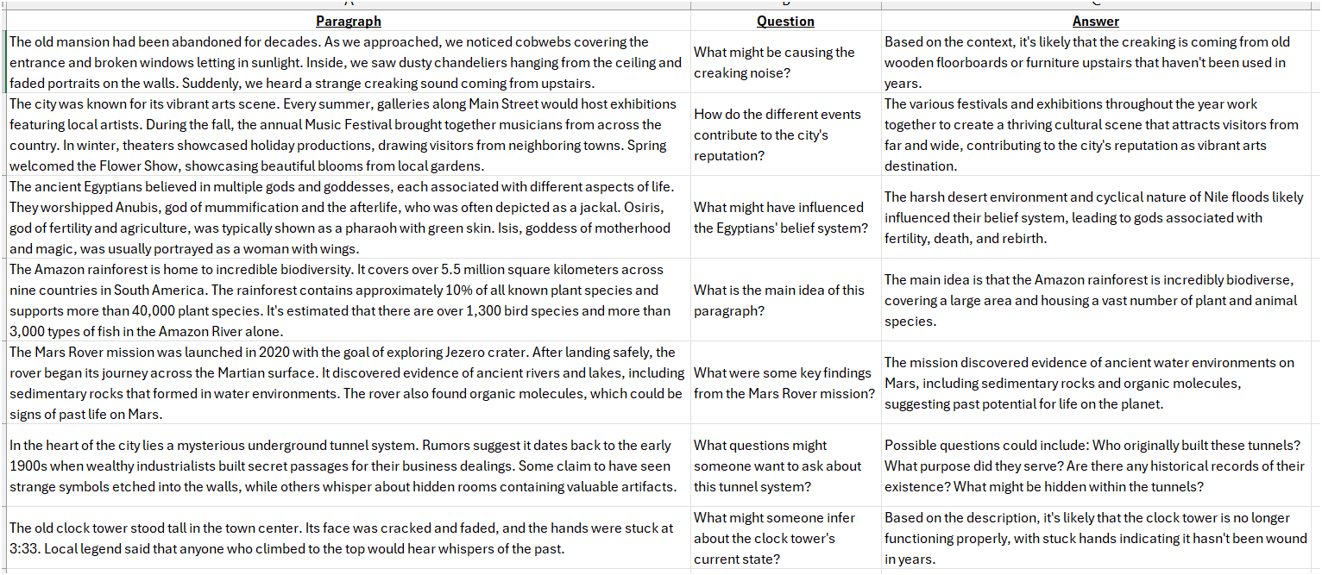
Data Collection
IT21118340 | S. A. D. S. Kumarathunga | 24-25J-027
3/18/2025
47
Notes:
Proposed system is designed with key functional goals in mind.
It will dynamically generate content tailored to the user's interests and skill level,
Accurately evaluate user responses without human intervention,
Provide extensive feedback on their answers.
On the non-functional side, focus is on ensuring accuracy, high performance, availability, and user-friendliness

Slide 48
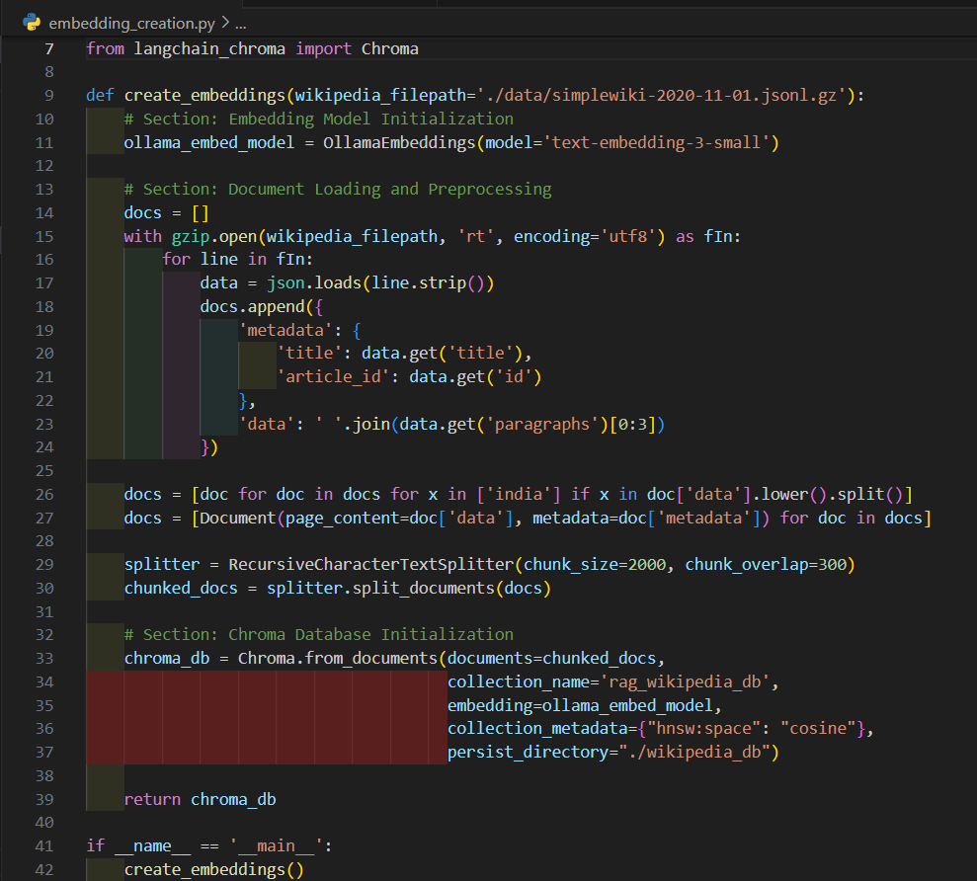
Embedding Creation
IT21118340 | S. A. D. S. Kumarathunga | 24-25J-027
3/18/2025
48
Notes:
Proposed system is designed with key functional goals in mind.
It will dynamically generate content tailored to the user's interests and skill level,
Accurately evaluate user responses without human intervention,
Provide extensive feedback on their answers.
On the non-functional side, focus is on ensuring accuracy, high performance, availability, and user-friendliness

Slide 49
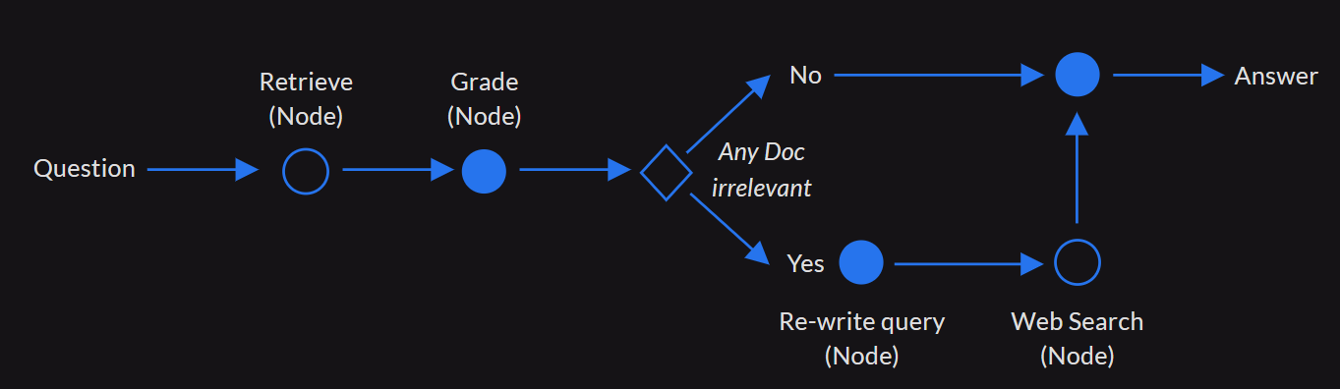
Corrective RAG
IT21118340 | S. A. D. S. Kumarathunga | 24-25J-027
3/18/2025
49
Notes:
Corrective RAG (CRAG) is an enhanced version of traditional RAG that incorporates self-reflection and self-grading mechanisms. It aims to improve the robustness of generation by addressing potential inaccuracies in document retrieval. CRAG includes several key components: a retriever to fetch relevant documents, a retrieval evaluator to assess document relevance, and a corrective processing step to validate and refine retrieved content before generation.

Slide 50
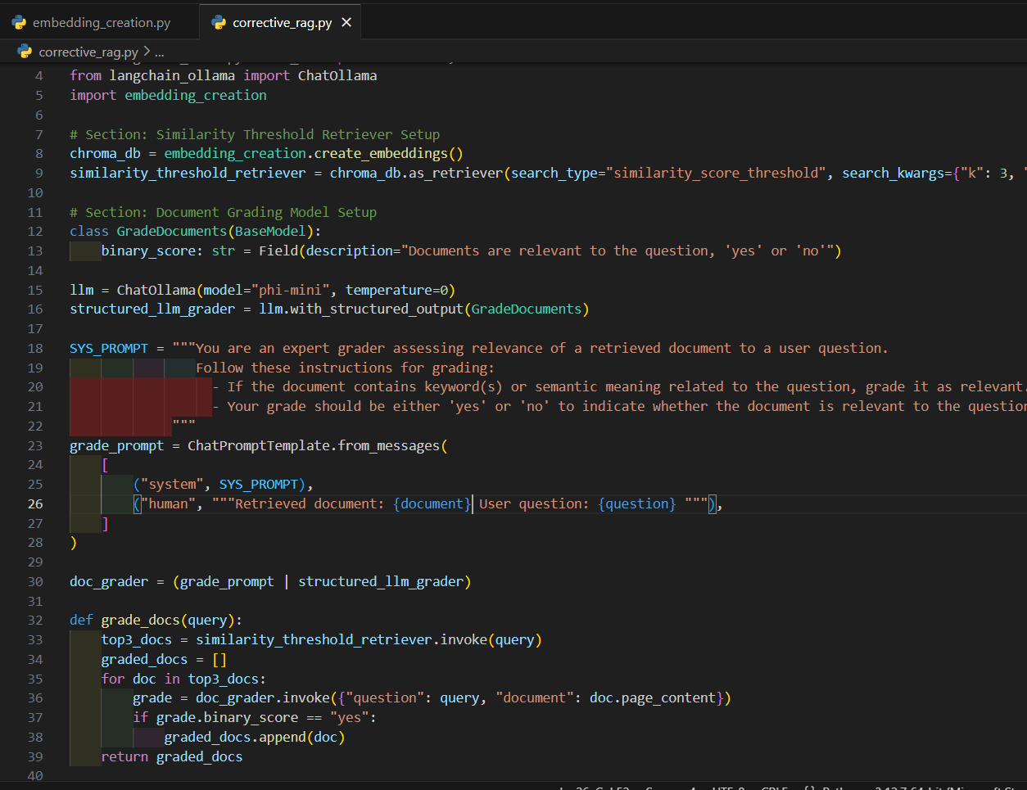
Corrective RAG
IT21118340 | S. A. D. S. Kumarathunga | 24-25J-027
3/18/2025
50
Notes:
Proposed system is designed with key functional goals in mind.
It will dynamically generate content tailored to the user's interests and skill level,
Accurately evaluate user responses without human intervention,
Provide extensive feedback on their answers.
On the non-functional side, focus is on ensuring accuracy, high performance, availability, and user-friendliness

Slide 51
AI Agent 🤖
An AI agent is a software program that perceives its environment and takes actions to achieve goals. It can interact with users, process information, and perform tasks autonomously.
Model: Microsoft Phi3 Mini
Good performance on NLP tasks despite its compact size (Less than 3GB).
Complete tasks with minimal computational resources;
Inference Engine: Ollama
Open-source platform. Cost free. Supports a wide range of models. Offering flexibility in choosing the right model for the tasks.
Architecture: ReAct Agent
Provide more accurate and contextually relevant responses.
Design Pattern: Tool Use/Tool Calling Pattern
Uses modularization, where tasks are assigned to specialized tools, enhancing efficiency, flexibility, and scalability.
IT21118340 | S. A. D. S. Kumarathunga | 24-25J-027
3/18/2025
51

Slide 52
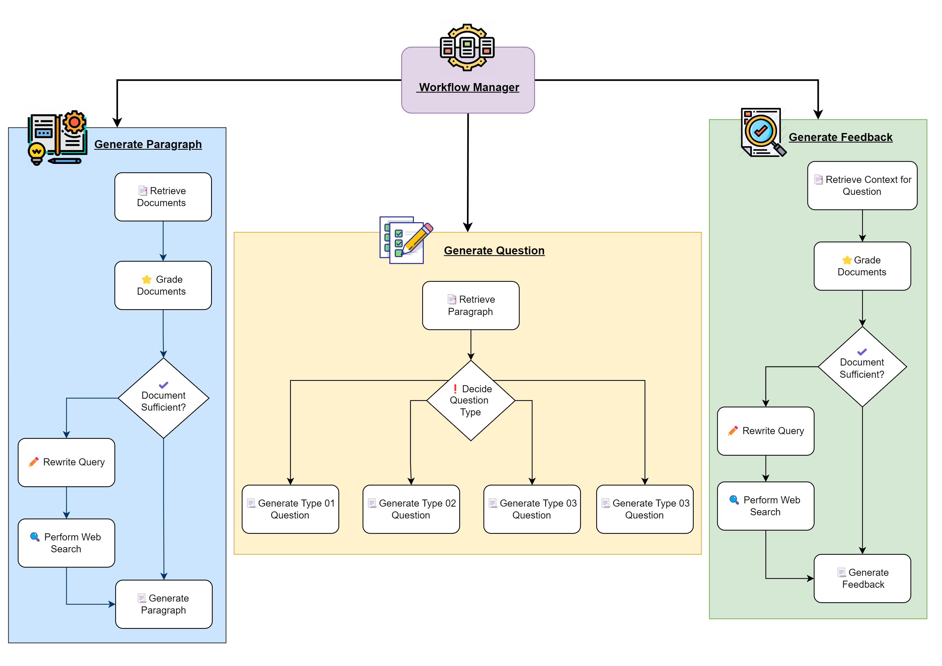
AI Agent High Level Diagram
IT21118340 | S. A. D. S. Kumarathunga | 24-25J-027
3/18/2025
52
Notes:
Three main workflows: generating paragraphs, generating questions, and generating feedback.
Workflow Manager: Determines the next step in the workflow based on the current state.

Slide 53
AI Agent - Implementation
IT21118340 | S. A. D. S. Kumarathunga | 24-25J-027
3/18/2025
53
Notes:
Proposed system is designed with key functional goals in mind.
It will dynamically generate content tailored to the user's interests and skill level,
Accurately evaluate user responses without human intervention,
Provide extensive feedback on their answers.
On the non-functional side, focus is on ensuring accuracy, high performance, availability, and user-friendliness

Slide 54
AI Agent - Demo
IT21118340 | S. A. D. S. Kumarathunga | 24-25J-027
3/18/2025
54
Notes:
Proposed system is designed with key functional goals in mind.
It will dynamically generate content tailored to the user's interests and skill level,
Accurately evaluate user responses without human intervention,
Provide extensive feedback on their answers.
On the non-functional side, focus is on ensuring accuracy, high performance, availability, and user-friendliness

Slide 55
UI Design - Figma
IT21118340 | S. A. D. S. Kumarathunga | 24-25J-027
3/18/2025
55
Notes:
Proposed system is designed with key functional goals in mind.
It will dynamically generate content tailored to the user's interests and skill level,
Accurately evaluate user responses without human intervention,
Provide extensive feedback on their answers.
On the non-functional side, focus is on ensuring accuracy, high performance, availability, and user-friendliness

Slide 56
To Be Completed [40%]
UI Design
Optimize Agent Workflows
Integrate RAG Pipeline with Cloud Storage
Frontend Implementation
IT21118340 | S. A. D. S. Kumarathunga | 24-25J-027
3/18/2025
56

Slide 57
Software Specification Requirements
Functional:
The system should be able to dynamically generate content given on user's interest and skill level
The system should be able to accurately evaluate user answer without human intervention
The system should be able to give extensive feedback about user's answer
Non Functional: Accuracy, Performance, Availability, Usability
IT21118340 | S. A. D. S. Kumarathunga | 24-25J-027
3/18/2025
57
Notes:
Proposed system is designed with key functional goals in mind.
It will dynamically generate content tailored to the user's interests and skill level,
Accurately evaluate user responses without human intervention,
Provide extensive feedback on their answers.
On the non-functional side, focus is on ensuring accuracy, high performance, availability, and user-friendliness

Slide 58
Other Requirements
Software:
Languages: JavaScript & Python
Web Frameworks: React & Django
Database: PostgresSQL
AI/ML: Llama, Vertex AI, LangChain
CI/CD – GitHub, Docker, Kubernetes
Personal:
Expertise in
Web frameworks
LLM related tools
Database Design
System Design & Deployment
IT21118340 | S. A. D. S. Kumarathunga | 24-25J-027
3/18/2025
58
Notes:
This is a list software I intend use to develop our system.
On the personal requirements, Expertise in web frameworks, LLM-related tools, database design, and system design and deployment are required.

Slide 59
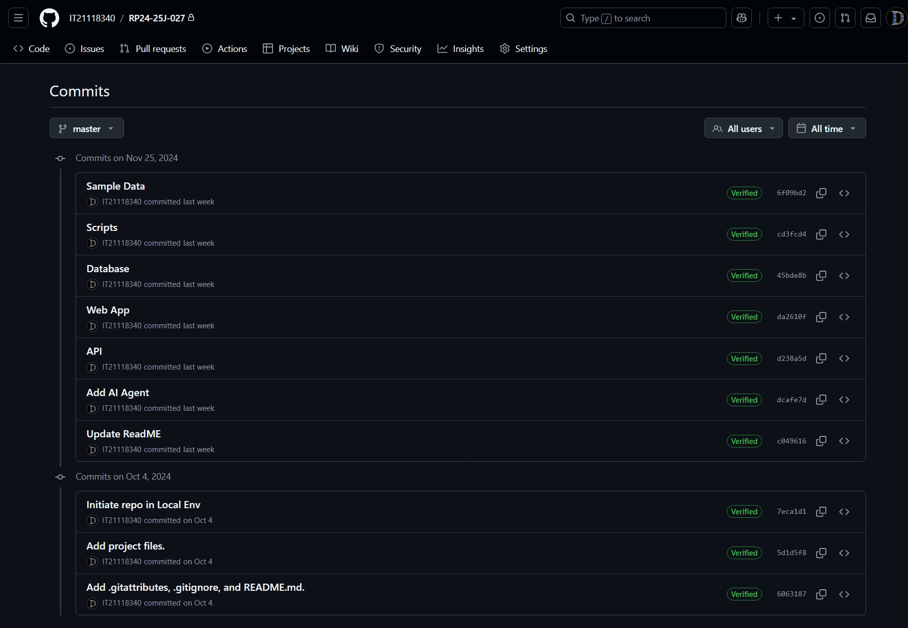
Github Commits
IT21118340 | S. A. D. S. Kumarathunga | 24-25J-027
3/18/2025
59
Notes:
This is a list software I intend use to develop our system.
On the personal requirements, Expertise in web frameworks, LLM-related tools, database design, and system design and deployment are required.

Slide 60
Risk Mitigation
Risk | Trigger | Owner | Response | Resource Required
High operational costs | Excessive cloud computing and infrastructure expenses | Team | Implement cost-saving strategies such as using smaller models | Product Backlog
Illness or sudden absence of the project team member(s) | Illness / Other personal emergencies | Leader | Inform to the supervisor and co-supervisor. Development team divides the functions with equal scope. | Project Schedule Plan / Gantt Chart
Changes requested by evaluation panel | Not satisfied with The product / presentation / outcome | Team | Do the necessary changes immediately. Update the changes in all required documents. Update the changes to the required persons. | Project Schedule Plan/Gantt Chart, Product Backlog, Meeting Log
Supervisor/s Request changes | Not satisfied with The Product / presentation / outcome | Team
Panel / Supervisor/s are not at the scheduled meetings | Illness / Other personal emergencies | Leader | Inform it to the required persons immediately. Reschedule the meeting/ do necessary alternatives | Meeting log, Emails
60
3/18/2025
3/18/2025
60

Slide 61
References
[1] K. Moholkar, M. Chaturvedi, A. Jain, A. Parkhe and K. Singh, "Machine Learning Techniques for Descriptive Answer Evaluation: A Comprehensive Survey," 2024 International Conference on Inventive Computation Technologies (ICICT), Lalitpur, Nepal, 2024, pp. 1412-1419, doi: 10.1109/ICICT60155.2024.10544714.
[2] P. Mirabal, M. Castillo-Sanhueza, R. Curín-Zarate and O. O. Calzadilla-Pérez, "Use of Language Models based on Deep Learning to improve reading comprehension," 2023 42nd IEEE International Conference of the Chilean Computer Science Society (SCCC), Concepcion, Chile, 2023, pp. 1-6, doi: 10.1109/SCCC59417.2023.10315757.
[3] Laban, P., Wu, C., Murakhovs'ka, L., Liu, W., & Xiong, C. (2022). Quiz Design Task: Helping Teachers Create Quizzes with Automated Question Generation. NAACL-HLT.
[4] Xia, W., Mao, S., & Zheng, C. (2024). Empirical Study of Large Language Models as Automated Essay Scoring Tools in English Composition Taking TOEFL Independent Writing Task for Example. ArXiv, abs/2401.03401.
[5] Hussein, M.A., Hassan, H.A., & Nassef, M. (2019). Automated language essay scoring systems: a literature review. PeerJ Computer Science, 5.
61
3/18/2025
IT21118340 | S. A. D. S. Kumarathunga | 24-25J-027
3/18/2025
61
Notes:
I would like invite Asanka to present his section.

Slide 62
Phoneme-Level Speech Error Detection Module
IT21182396 – A. P. Ranaweera
IT21182396 | A. P. Ranaweera | 24-25J-027
3/18/2025
62

Slide 63
Background
Accurate pronunciation is essential for effective English reading and comprehensions, but phoneme-level errors can disrupt understanding.
Machine learning enables accurate detection of speech errors by analyzing audio and identifying wrong phonemes.
Providing similar-sounding word suggestions helps users practice and improve their pronunciation effectively.
IT21182396 | A. P. Ranaweera | 24-25J-027
3/18/2025
63
Notes:
Identify student current performance level and develop a personalized learing path base on it . So that after identify current level… system predict which level is the appropriate quiz for next
Based on what the user entered in the quiz ,,,, at that time ML algorithm analyze the data accurately… assess each user s proficiency…. And determine the appropriate level of quiz to present to next.

Slide 64
Research Problem?
How can a machine learning-based web application effectively detect phoneme-level speech errors and provide targeted feedback, including similar-sounding word suggestions, to improve pronunciation and enhance English language learning?
IT21182396 | A. P. Ranaweera | 24-25J-027
3/18/2025
64
Notes:
That kind of english reading and comprehension improving platfor............
We have compared the existing platgorm and.... ifentifyy what feature should be included to our ptoposed one.... included the additional things of our proposed applicationWe have included personalized learning path feature in our proposed systemPlan to measure student performance in several ways

Slide 65
Research Objectives
Main Objective:
To develop a machine learning-based web application for accurate detection of phoneme-level speech errors and provide corrective feedback, including similar-sounding word suggestions, to enhance pronunciation and English language learning.
Sub Objectives:
To collect comprehensive dataset of audio files with corresponding phoneme sequences for training and evaluation.
To design and train a machine learning model capable of accurately detecting phoneme-level errors in spoken words.
To implement a feedback system that identifies mispronounced phonemes and suggests similar-sounding words for practice.
IT21182396 | A. P. Ranaweera | 24-25J-027
3/18/2025
65
Notes:
There are anlyze the time pet for session and analyzing the time spent on one question … according to that odentifying student level
For that compare with the time spent by him…time it usually takes to complete a question of that level
Comparison of the number of qus student get wrong in that level session
Compare his mistakes wrong patterns
The difficulty level of the question can be enterd acodrindgto how the student felt at the end of the question
anlyze the behavior in this earkier kevel
Use this kind of parameters buy analize accordingly he ca gather numb er of point acrding to it determine what kind of level would be the

Slide 66
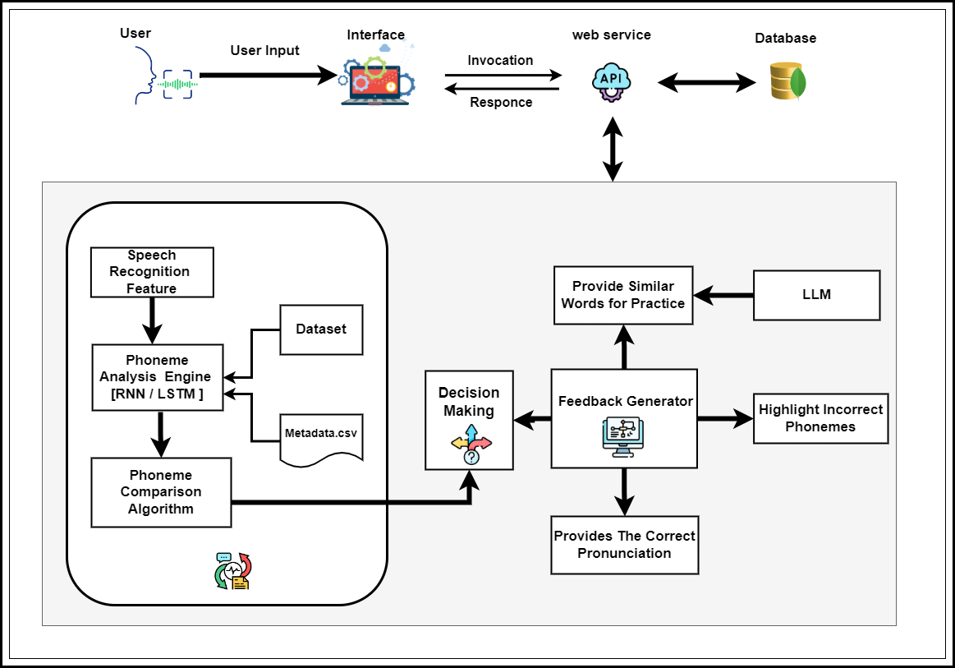
System Design
IT21182396 | A. P. Ranaweera | 24-25J-027
3/18/2025
66
Notes:
There are anlyze the time pet for session and analyzing the time spent on one question … according to that odentifying student level
For that compare with the time spent by him…time it usually takes to complete a question of that level
Comparison of the number of qus student get wrong in that level session
Compare his mistakes wrong patterns
The difficulty level of the question can be enterd acodrindgto how the student felt at the end of the question
anlyze the behavior in this earkier kevel
We are plane to train data set that include average time taken for each level of questions
After we gather user inputs analize varies type of models .. So that how many presentage effect to the output … from this type of parameter .. According to that finally cal how many point gather from current level.
Use this kind of parameters buy analize accordingly he ca gather numb er of point acrding to it determine what kind of level would be the next

Slide 67
Tools & Technologies
Frontend - JavaScript & React
Backend – FastAPI
Database – mongoDB
.
Deep Learning Frameworks - TensorFlow
Audio Processing – MFCCs
RNN-Based Techniques - LSTM
IT21182396 | A. P. Ranaweera | 24-25J-027
3/18/2025
67

Slide 68
Software Specification Requirements
Functional:
Import and manage datasets containing audio files and associated metadata.
Extract relevant features such as MFCCs, for model training.
Implement RNN-based models like LSTMs to recognize phonemes from input audio sequences.
Identify pronunciation errors at the phoneme level.
Provide detailed feedback, including the correct pronunciation, provide similar sounding words.
Non Functional: Accuracy , Performance, Availability, Usability
IT21182396 | A. P. Ranaweera | 24-25J-027
3/18/2025
68

Slide 69
Other Requirements
Software:
Languages: JavaScript & Python
Web Frameworks: React
Database: mongo DB
ML: TensorFlow
Google-colab
Personal:
Expertise in Web frameworks
Expertise in ML related tools
Expertise in Database Design
Expertise in System Design & Deployment
IT21182396 | A. P. Ranaweera | 24-25J-027
3/18/2025
69

Slide 70
Progress up to now
The phoneme-sequenced model training is currently in progress.
Some components of the UI for the web application have been developed.
IT21182396 | A. P. Ranaweera | 24-25J-027
3/18/2025
70

Slide 71
What is to be done
Continue training the model for enhanced accuracy.
Expand and improve the dataset.
Integrate accurate pre-trained models for phoneme error detection.
Continue training the model for enhanced accuracy. [ Expand and improve the dataset. Integrate accurate pre-trained models for phoneme error detection.]
Develop a system to suggest similar-sounding words for identified errors.
Complete integration of the model and features with the web application's UI.
IT21182396 | A. P. Ranaweera | 24-25J-027
3/18/2025
71

Slide 72
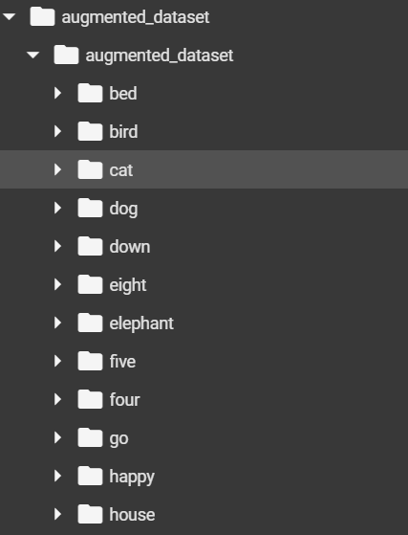
Dataset Organization
Continue training the model for enhanced accuracy.
Expand and improve the dataset.
Integrate accurate pre-trained models for phoneme error detection.
Audio Recordings
Metadata
IT21182396 | A. P. Ranaweera | 24-25J-027
3/18/2025
72
Notes:
Audio Recordings : We used collection of audio recordings. That consist with Pronunciations of words by native and non-native speakers.
Metadata.csv file :
* automate the creation of a metadata file for audio datasets. Metadata is essential for organizing datasets
* It includes file names, paths, phonemes, and transcriptions
* Links words to their phonetic representations using the phoneme dictionary

Slide 73
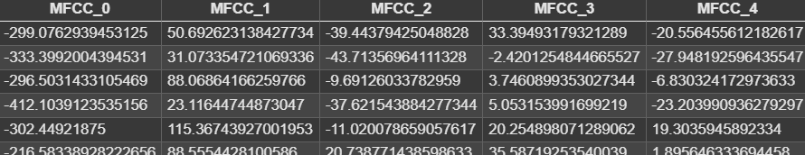
Preprocessing Audio Files
Continue training the model for enhanced accuracy.
Expand and improve the dataset.
Integrate accurate pre-trained models for phoneme error detection.
Converts raw audio signals into numerical representations (MFCCs) for machine learning.
Data Normalization: Standardizes audio to ensure consistent amplitude levels.
Dataset Augmentation: Adds MFCC features to the metadata for model training.
IT21182396 | A. P. Ranaweera | 24-25J-027
3/18/2025
73
Notes:
Slide topic::::::::::::::::
preprocessing audio files to extract key features that are used in speech recognition, pronunciation evaluation,
Slide:::::::
--Uses librosa to load and resample audio files to a target sampling rate (16 kHz by default).
--Normalizes audio to ensure consistent range and reduce noise.
--Computes a set of 13 MFCC features from each audio file.
-- Create file that Combines, file paths, words, phonemes, and extracted features into a structured CSV file for training.

Slide 74
Design the Model
Continue training the model for enhanced accuracy.
Expand and improve the dataset.
Integrate accurate pre-trained models for phoneme error detection.
Prepare the data for the RNN model.
Design the model architecture using an RNN (LSTM or GRU layers).
Train the model on preprocessed audio features (MFCCs) and phoneme mappings.
Evaluate the model's performance.
Prepare the data for the RNN model.
Design the model architecture using an RNN (RNN architecture with LSTM).
Train the model on preprocessed audio features (MFCCs) and phoneme mappings.
Evaluate the model's performance.
IT21182396 | A. P. Ranaweera | 24-25J-027
3/18/2025
74
Notes:
Slide eke ewa epaa…
Slide topic:::::
--implements a phoneme classification system using a Recurrent Neural Network (RNN) with Long Short-Term Memory (LSTM) layers
--It leverages the preprocessed MFCC features from the earlier stages and trains a model to predict phonemes based on these features.
That RNN with LSTMs::::: LSTMs handle sequential data like MFCC features effectively,Maps MFCC features to phoneme categories.
After Trains the Model,,,,,,,
Runs training for 20 epochs with a batch size of 32.

Slide 75
Model Optimizations approaches
Continue training the model for enhanced accuracy.
Expand and improve the dataset.
Integrate accurate pre-trained models for phoneme error detection.
Prepare the data for the RNN model.
Design the model architecture using an RNN (LSTM or GRU layers).
Train the model on preprocessed audio features (MFCCs) and phoneme mappings.
Evaluate the model's performance.
1. Data Augmentation
Enhance the training dataset by artificially increasing its diversity using transformations like adding noise, pitch shifting, and time stretching.
2. Hyperparameter Tuning
Optimize the model’s hyperparameters (e.g., LSTM units, dense units, learning rate) to find the best configuration for performance.
IT21182396 | A. P. Ranaweera | 24-25J-027
3/18/2025
75
Notes:
Slide eke ewa epaa…
Slide topic:::::
--implements a phoneme classification system using a Recurrent Neural Network (RNN) with Long Short-Term Memory (LSTM) layers
--It leverages the preprocessed MFCC features from the earlier stages and trains a model to predict phonemes based on these features.
That RNN with LSTMs::::: LSTMs handle sequential data like MFCC features effectively,Maps MFCC features to phoneme categories.
After Trains the Model,,,,,,,
Runs training for 20 epochs with a batch size of 32.

Slide 76
Model Optimizations approaches
Continue training the model for enhanced accuracy.
Expand and improve the dataset.
Integrate accurate pre-trained models for phoneme error detection.
Prepare the data for the RNN model.
Design the model architecture using an RNN (LSTM or GRU layers).
Train the model on preprocessed audio features (MFCCs) and phoneme mappings.
Evaluate the model's performance.
3. Dropout Layers
That use for Prevent overfitting during training
4. Regularization and Learning Rate Scheduler
Address overfitting and improve learning efficiency over time.
IT21182396 | A. P. Ranaweera | 24-25J-027
3/18/2025
76
Notes:
Slide eke ewa epaa…
Slide topic:::::
--implements a phoneme classification system using a Recurrent Neural Network (RNN) with Long Short-Term Memory (LSTM) layers
--It leverages the preprocessed MFCC features from the earlier stages and trains a model to predict phonemes based on these features.
That RNN with LSTMs::::: LSTMs handle sequential data like MFCC features effectively,Maps MFCC features to phoneme categories.
After Trains the Model,,,,,,,
Runs training for 20 epochs with a batch size of 32.

Slide 77
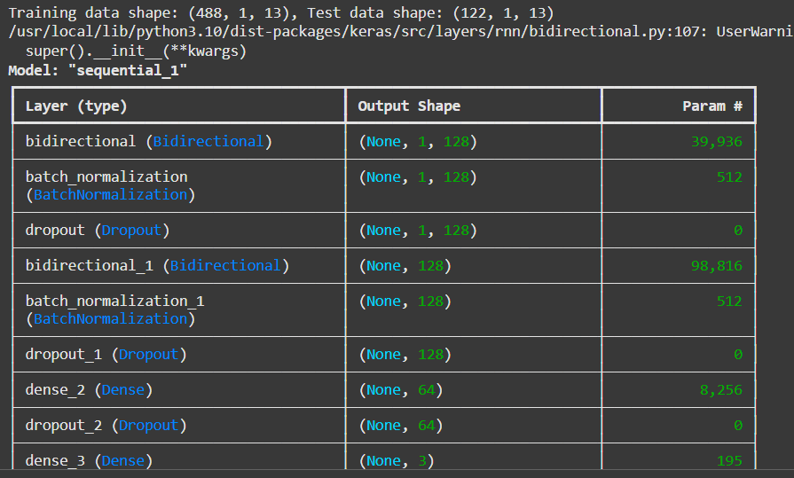
Train Model
Continue training the model for enhanced accuracy.
Expand and improve the dataset.
Integrate accurate pre-trained models for phoneme error detection.
Prepare the data for the RNN model.
Design the model architecture using an RNN (LSTM or GRU layers).
Train the model on preprocessed audio features (MFCCs) and phoneme mappings.
Evaluate the model's performance.
IT21182396 | A. P. Ranaweera | 24-25J-027
3/18/2025
77
Notes:
-- In the training part we can see layers and output shape and parameters

Slide 78
Train Model
Continue training the model for enhanced accuracy.
Expand and improve the dataset.
Integrate accurate pre-trained models for phoneme error detection.
Prepare the data for the RNN model.
Design the model architecture using an RNN (LSTM or GRU layers).
Train the model on preprocessed audio features (MFCCs) and phoneme mappings.
Evaluate the model's performance.
IT21182396 | A. P. Ranaweera | 24-25J-027
3/18/2025
78
Notes:
-- After training we can get accuracy result and lost result

Slide 79
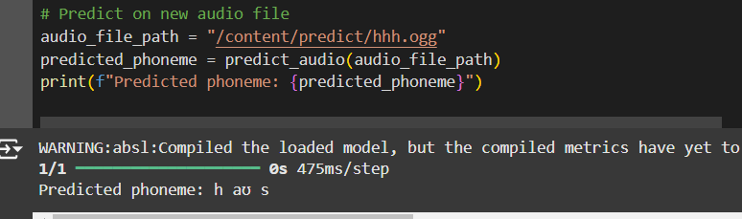
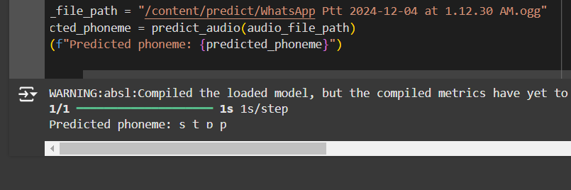
Predict On New Audio File
Continue training the model for enhanced accuracy.
Expand and improve the dataset.
Integrate accurate pre-trained models for phoneme error detection.
Prepare the data for the RNN model.
Design the model architecture using an RNN (LSTM or GRU layers).
Train the model on preprocessed audio features (MFCCs) and phoneme mappings.
Evaluate the model's performance.
IT21182396 | A. P. Ranaweera | 24-25J-027
3/18/2025
79
Notes:
-- Using unseen audio file we can predict output… this is path of the file.. It has been pronounced as house. That pronounced as stop..

Slide 80
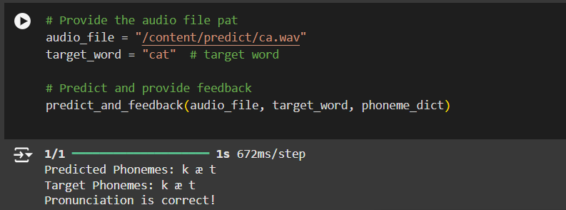
Compare With Expected Word
Continue training the model for enhanced accuracy.
Expand and improve the dataset.
Integrate accurate pre-trained models for phoneme error detection.
Prepare the data for the RNN model.
Design the model architecture using an RNN (LSTM or GRU layers).
Train the model on preprocessed audio features (MFCCs) and phoneme mappings.
Evaluate the model's performance.
IT21182396 | A. P. Ranaweera | 24-25J-027
3/18/2025
80
Notes:
This gives the phoneme of certain words… In this case , I think that the size of dataset is not enough.. Some times errors are highited in mispronounciations. It should be correct in the future..

Slide 81
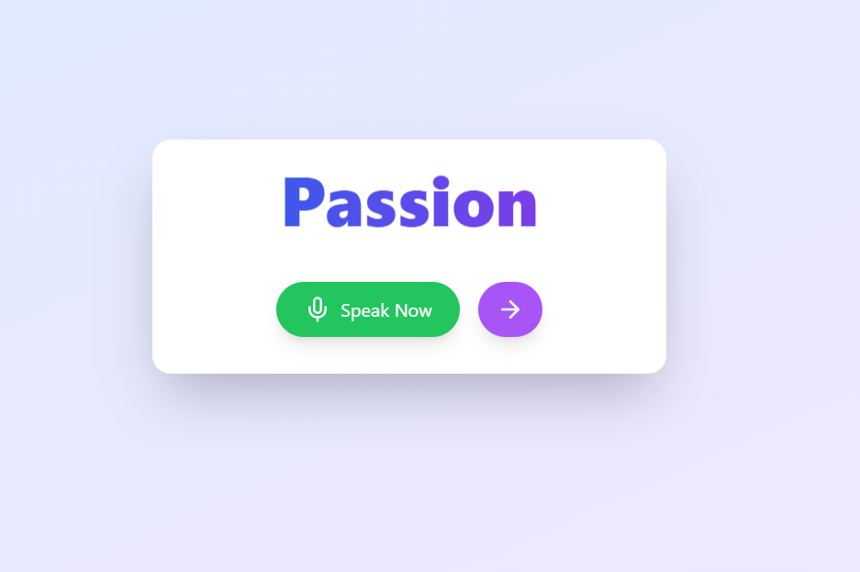
User Interface
Continue training the model for enhanced accuracy.
Expand and improve the dataset.
Integrate accurate pre-trained models for phoneme error detection.
Prepare the data for the RNN model.
Design the model architecture using an RNN (LSTM or GRU layers).
Train the model on preprocessed audio features (MFCCs) and phoneme mappings.
Evaluate the model's performance.
IT21182396 | A. P. Ranaweera | 24-25J-027
3/18/2025
81
Notes:
That is Implemented User interface .Still This provide record the audio and we can listen it

Slide 82
Supportive Information Commercialization
Target Audience: High school students, English language learners, Educators
Business Model: Software as a Service
Free tier: Ad Supported ( Advertisements from education institutions)
Premium version: Subscription based
Marketing:
Establish partnerships with educational institutions to pilot and scale the product
Explore collaborations with government agencies and non-profit organizations focused on literacy and education
82
3/18/2025
3/18/2025
82

Slide 83
Supportive Information Budget
Resource​​ | Cost Per Month​ | Cost (LKR)​
Direct Costs​ | ​ | ​
Deployment cost​ | $28​ | LKR 15000.00
Domain​ | $15​ | LKR 5000.00
Indirect Costs​ | ​ | ​
Wi-Fi / mobile data​ | $​5 | LKR 3000.00​
83
3/18/2025
3/18/2025
83

Slide 84
Thank You
Any questions??
84
3/18/2025
3/18/2025
84

